Slide 1
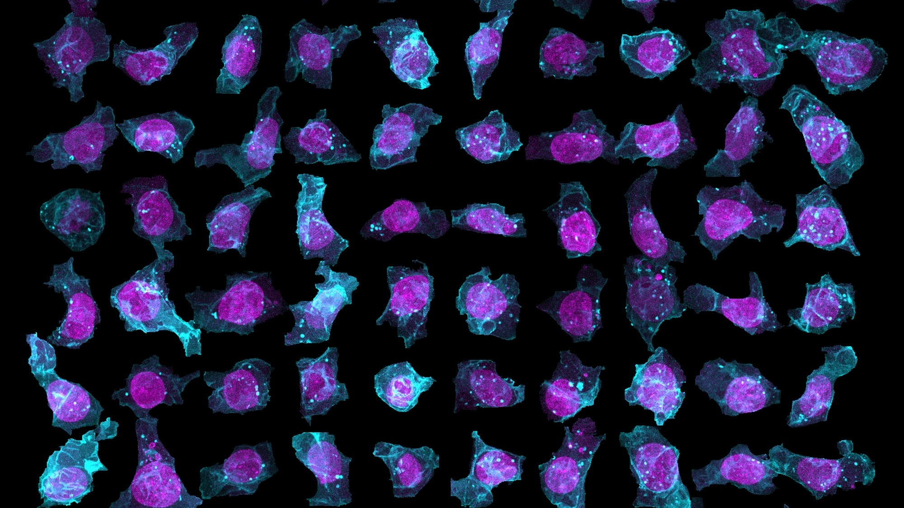
Student Cell Catalog
Notes:
Image credit: Allen Institute for Cell Science

Slide 2
Your Assignment:
Pick a partner and go to allencell.org/deep-cell-zoom
Please note: the interface is designed for use on a computer (laptop or desktop) and may not function as expected on a touchscreen (tablet or phone). We strongly recommend using a computer.
Work together to zoom in and scroll until you can find one cell that you believe represents each of the following stages of the cell cycle and mitosis.
Interphase, Prophase, Metaphase, Anaphase, Telophase/Cytokinesis
Take a screenshot of each cell and paste them in your "cell catalog" assignment. Include a 1-2 sentence summary justifying your selection.

Slide 3
Please remember to save this assignment

Slide 4
Tips & Tricks
This tool features over 200,000 cells, so it can take a while to find one that appears to have been imaged in the phase you are looking for!
These cells have all sorts of structures fluorescently labeled, and it is OK to be unsure which structure is shown! Just be sure to provide an explanation for why you chose that cell and why you think it displays the particular phase you were looking for.
If your zoom and/or scroll function stops working, try refreshing the page.

Slide 5
Screenshot shortcuts:
On a Mac: shift + command + 4
On a PC: Windows Logo Key + PrtScn button

Slide 6
Create your Cell Catalog using the following slides

Slide 7
Interphase
Why do you think this cell is in interphase? Justify your answer in 1-2 sentences.
Type your answer here.
What structure do you think is fluorescently tagged in the cell that you selected? Justify your answer in 1-2 sentences.
Type your answer here.
Copy & paste the screenshot of the cell you selected here

Slide 8
Prophase
Why do you think this cell is in prophase? Justify your answer in 1-2 sentences.
Type your answer here.
What structure do you think is fluorescently tagged in the cell that you selected? Justify your answer in 1-2 sentences.
Type your answer here.
Copy & paste the screenshot of the cell you selected here

Slide 9
Metaphase
Why do you think this cell is in metaphase? Justify your answer in 1-2 sentences.
Type your answer here.
What structure do you think is fluorescently tagged in the cell that you selected? Justify your answer in 1-2 sentences.
Type your answer here.
Copy & paste the screenshot of the cell you selected here

Slide 10
Anaphase
Why do you think this cell is in anaphase? Justify your answer in 1-2 sentences.
Type your answer here.
What structure do you think is fluorescently tagged in the cell that you selected? Justify your answer in 1-2 sentences.
Type your answer here.
Copy & paste the screenshot of the cell you selected here

Slide 11
Telophase/Cytokinesis
Why do you think this cell is in telophase or cytokinesis? Justify your answer in 1-2 sentences.
Type your answer here.
What structure do you think is fluorescently tagged in the cell that you selected? Justify your answer in 1-2 sentences.
Type your answer here.
Copy & paste the screenshot of the cell you selected here

Slide 12
If you have any lingering questions or comments after completing your cell catalog, please share them below:
[type here]
Please remember to save this assignment!

