Slide 1
"Realistic" pipe cleaner neurons
Build pipe cleaner neurons based on real neurons!
Grace Williams
Clare Gamlin, PhD
1/24/23

Slide 2
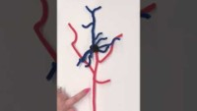
Basically Science!

Slide 3
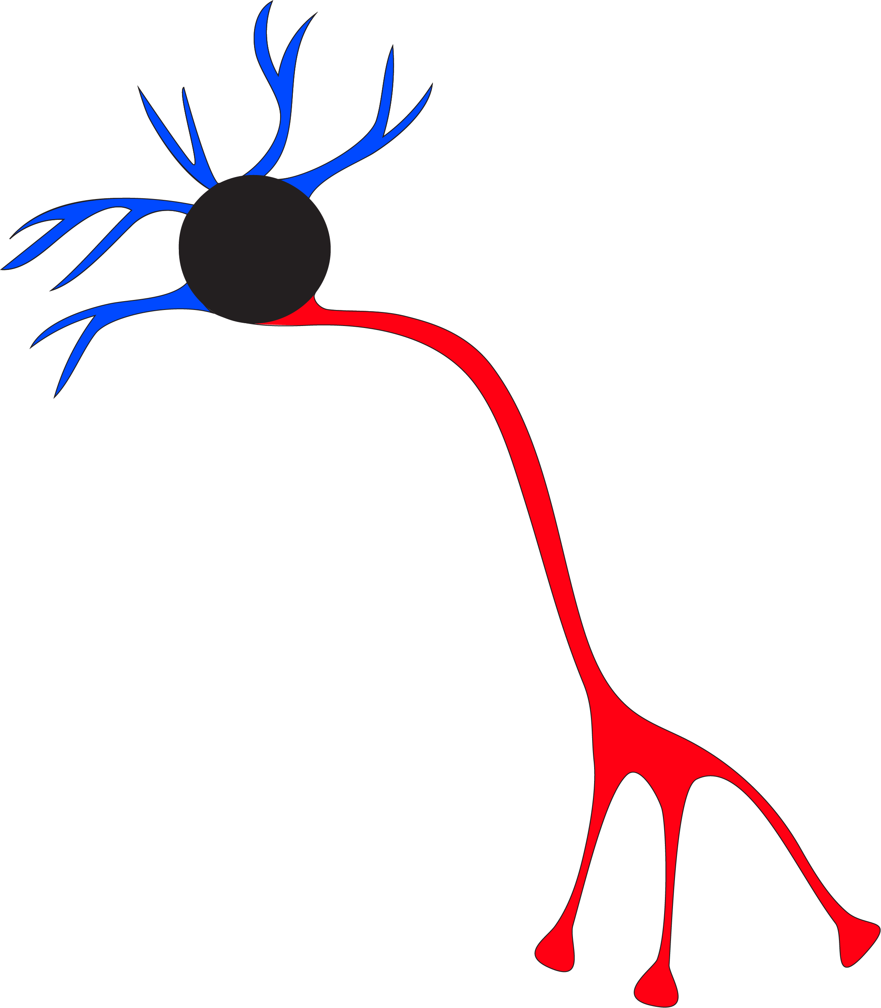
What is a neuron?
Dendrites
A neuron is a brain cell
Neurons have 3 main parts:
Cell Body
Dendrites
Axon
This is a diagram of a neuron, but most
neurons don't actually look like this
Cell Body (AKA Soma)
Axon
Notes:
What is a neuron? What do they look like? (Why do they have different shapes?)
A neuron is a brain cell.
Neurons have 3 main parts:
Cell body (soma)
Dendrite (where signal comes into the neuron)
Axon (where signal leaves the neuron)
Now have the students draw the example diagram & label
This is a diagram or model of a neuron –but not what neurons actually look like!
Neurons come in all shapes and sizes. Let's look at the next slide for two examples.

Slide 4
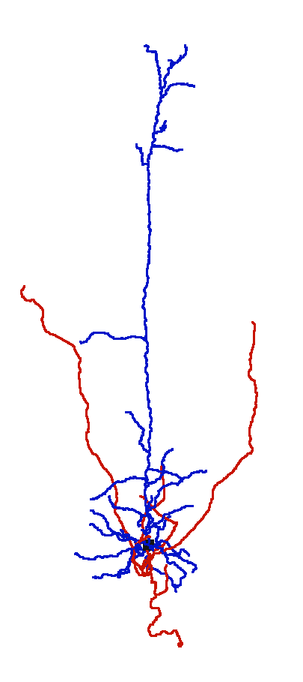
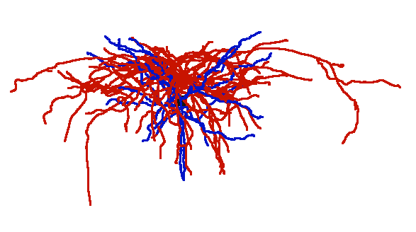
What do real neurons look like?
Inhibitory
Excitatory
Dendrite
Axon
Soma
Dendrite
Axon
Dendrite
Soma
Soma
Axon
(Figures not to scale)
Notes:
Possible questions:
What do you think an excitatory cell does? What do you think an inhibitory cell does?
Excitatory cells excite other cells and inhibitory cells quiet (inhibit) other cells
See: What do you see? How does this cell look different from the diagram?
Unlike the diagram, cell somas are relatively small compared to axons and dendrites.
Axons and dendrites come in all patterns and sizes.
Etc.
The excitatory cell has dendrites that reach far from the soma. The axon reaches out to the side. Who talks to this neuron, and who does this neuron talk to?
The inhibitory cell has short dendrites that stay in the neighborhood. The axon also stays close to the soma and completely overlaps with the dendrites.
What do you think the functions of these cells are based on what you see? (Do these cells listen and talk to similar groups? If not, how do they differ?)

Slide 5
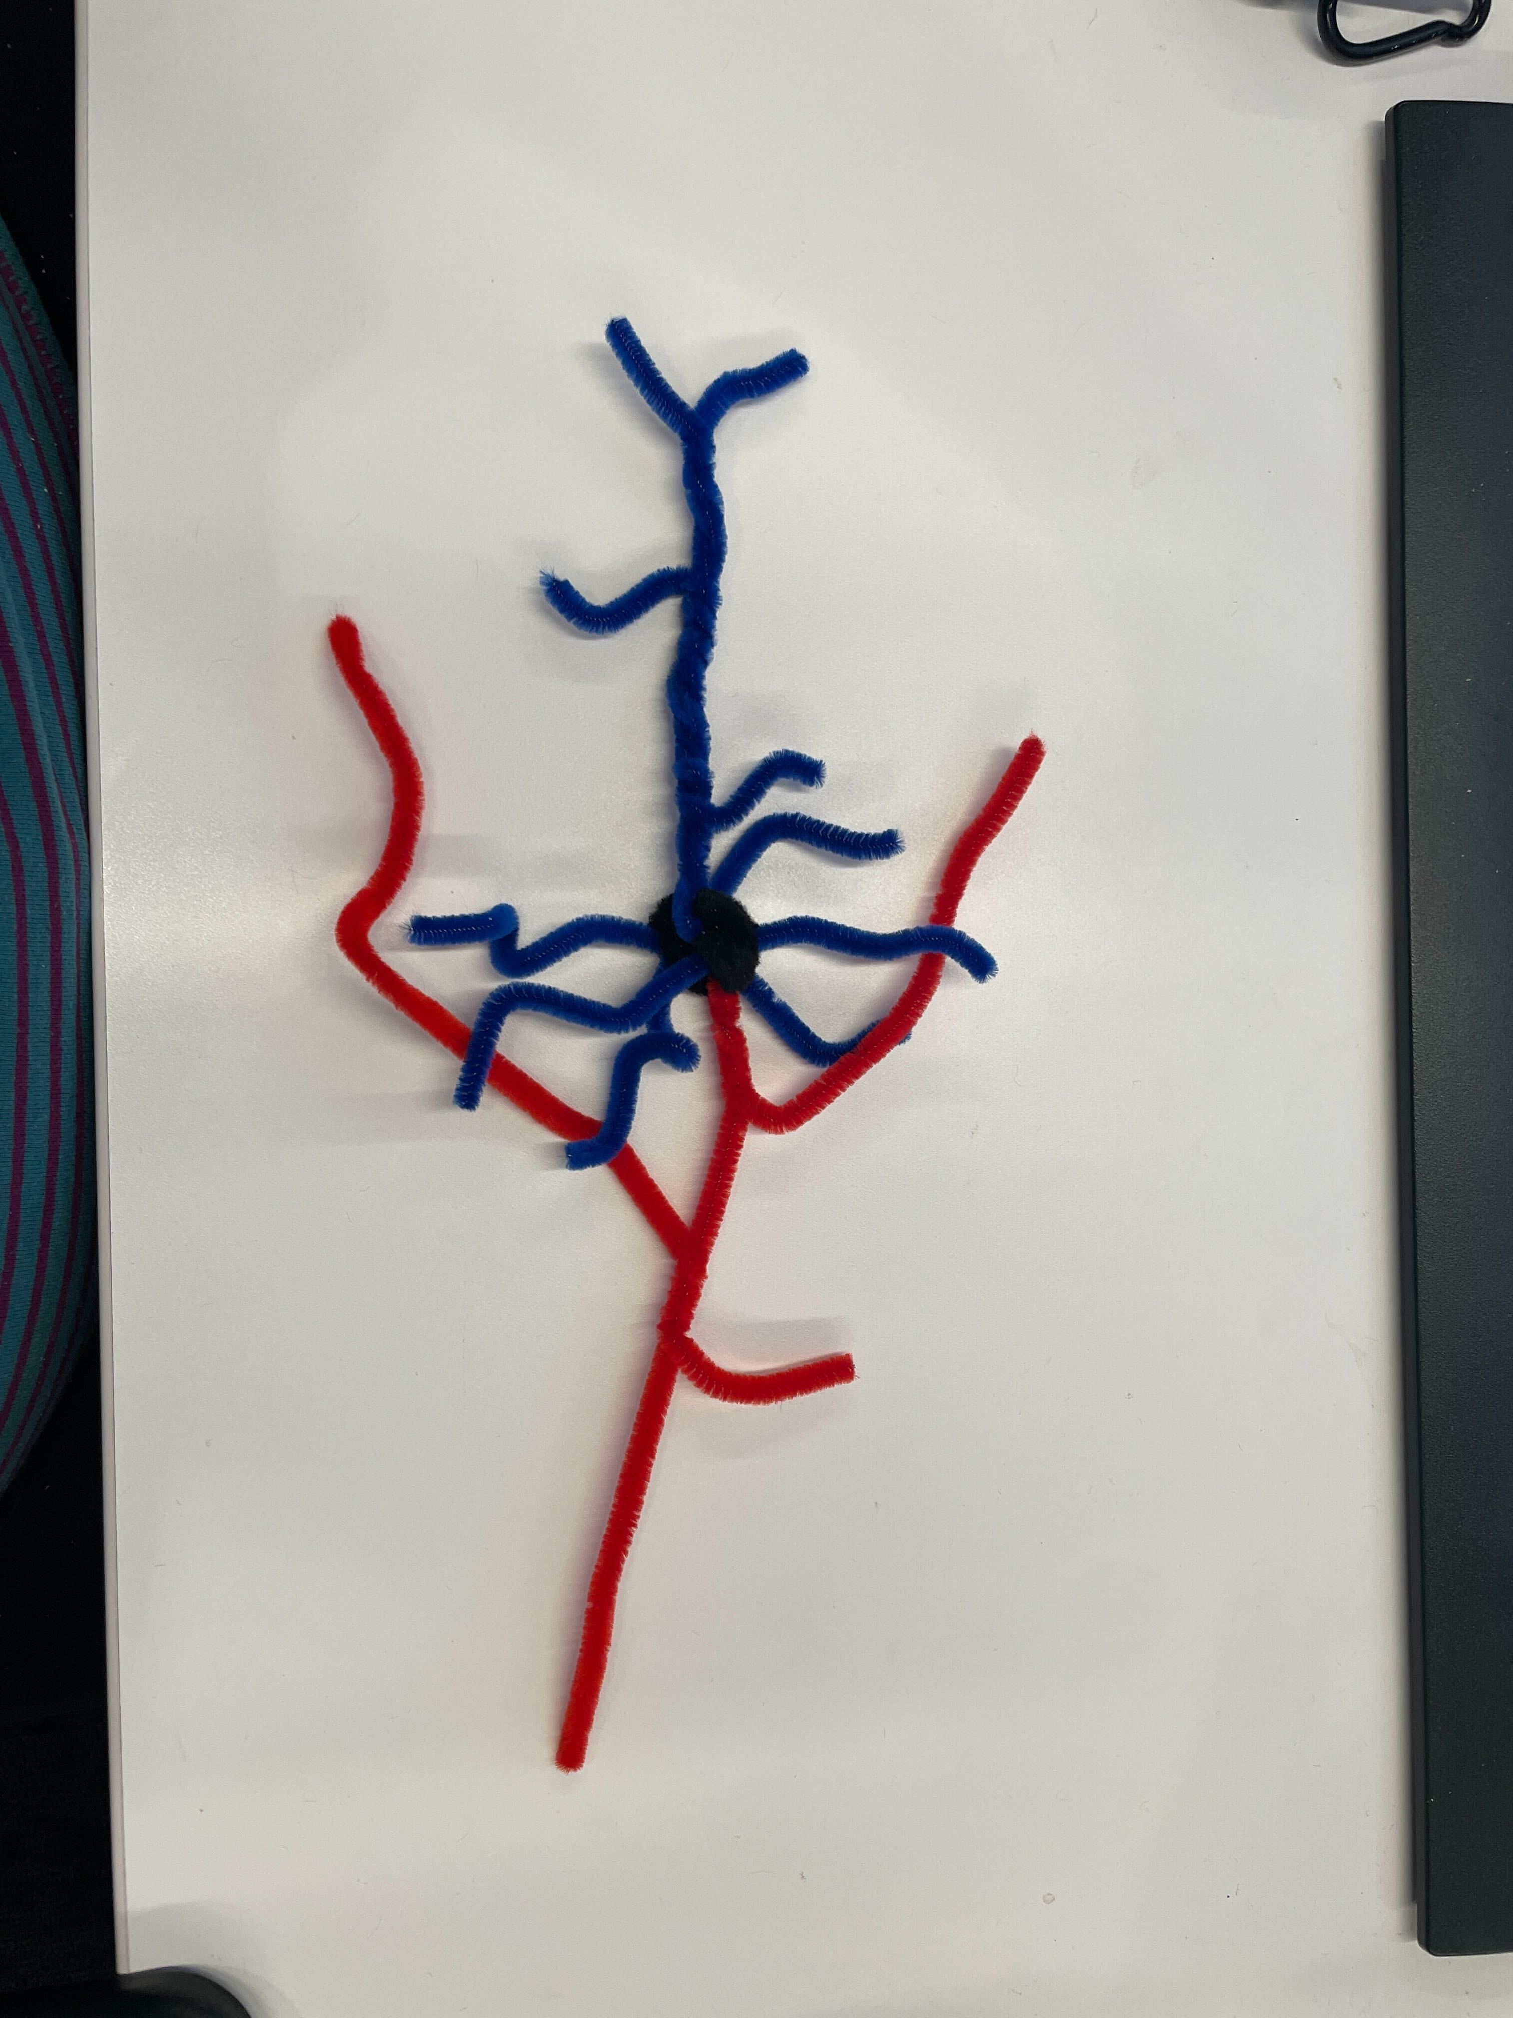
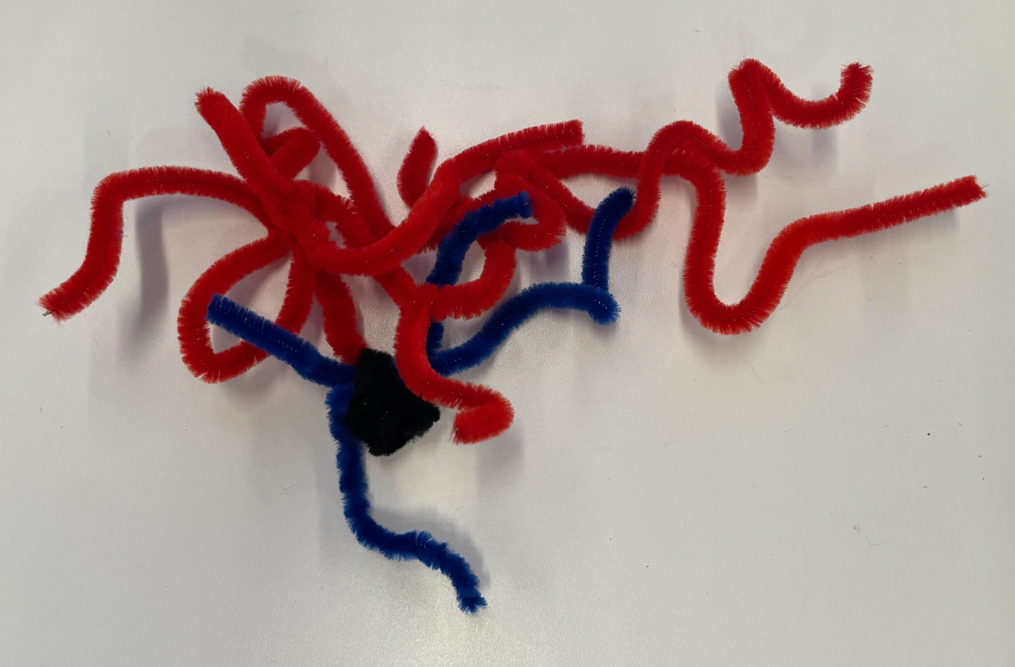
Pipe cleaner neurons
Excitatory
1 black pipe cleaner
2 red pipe cleaners
3 blue pipe cleaners
Scissors
Inhibitory
1 black pipe cleaner
1 blue pipe cleaner
3 red pipe cleaners
Scissors
Notes:
Have students made the excitatory cell first

Slide 6
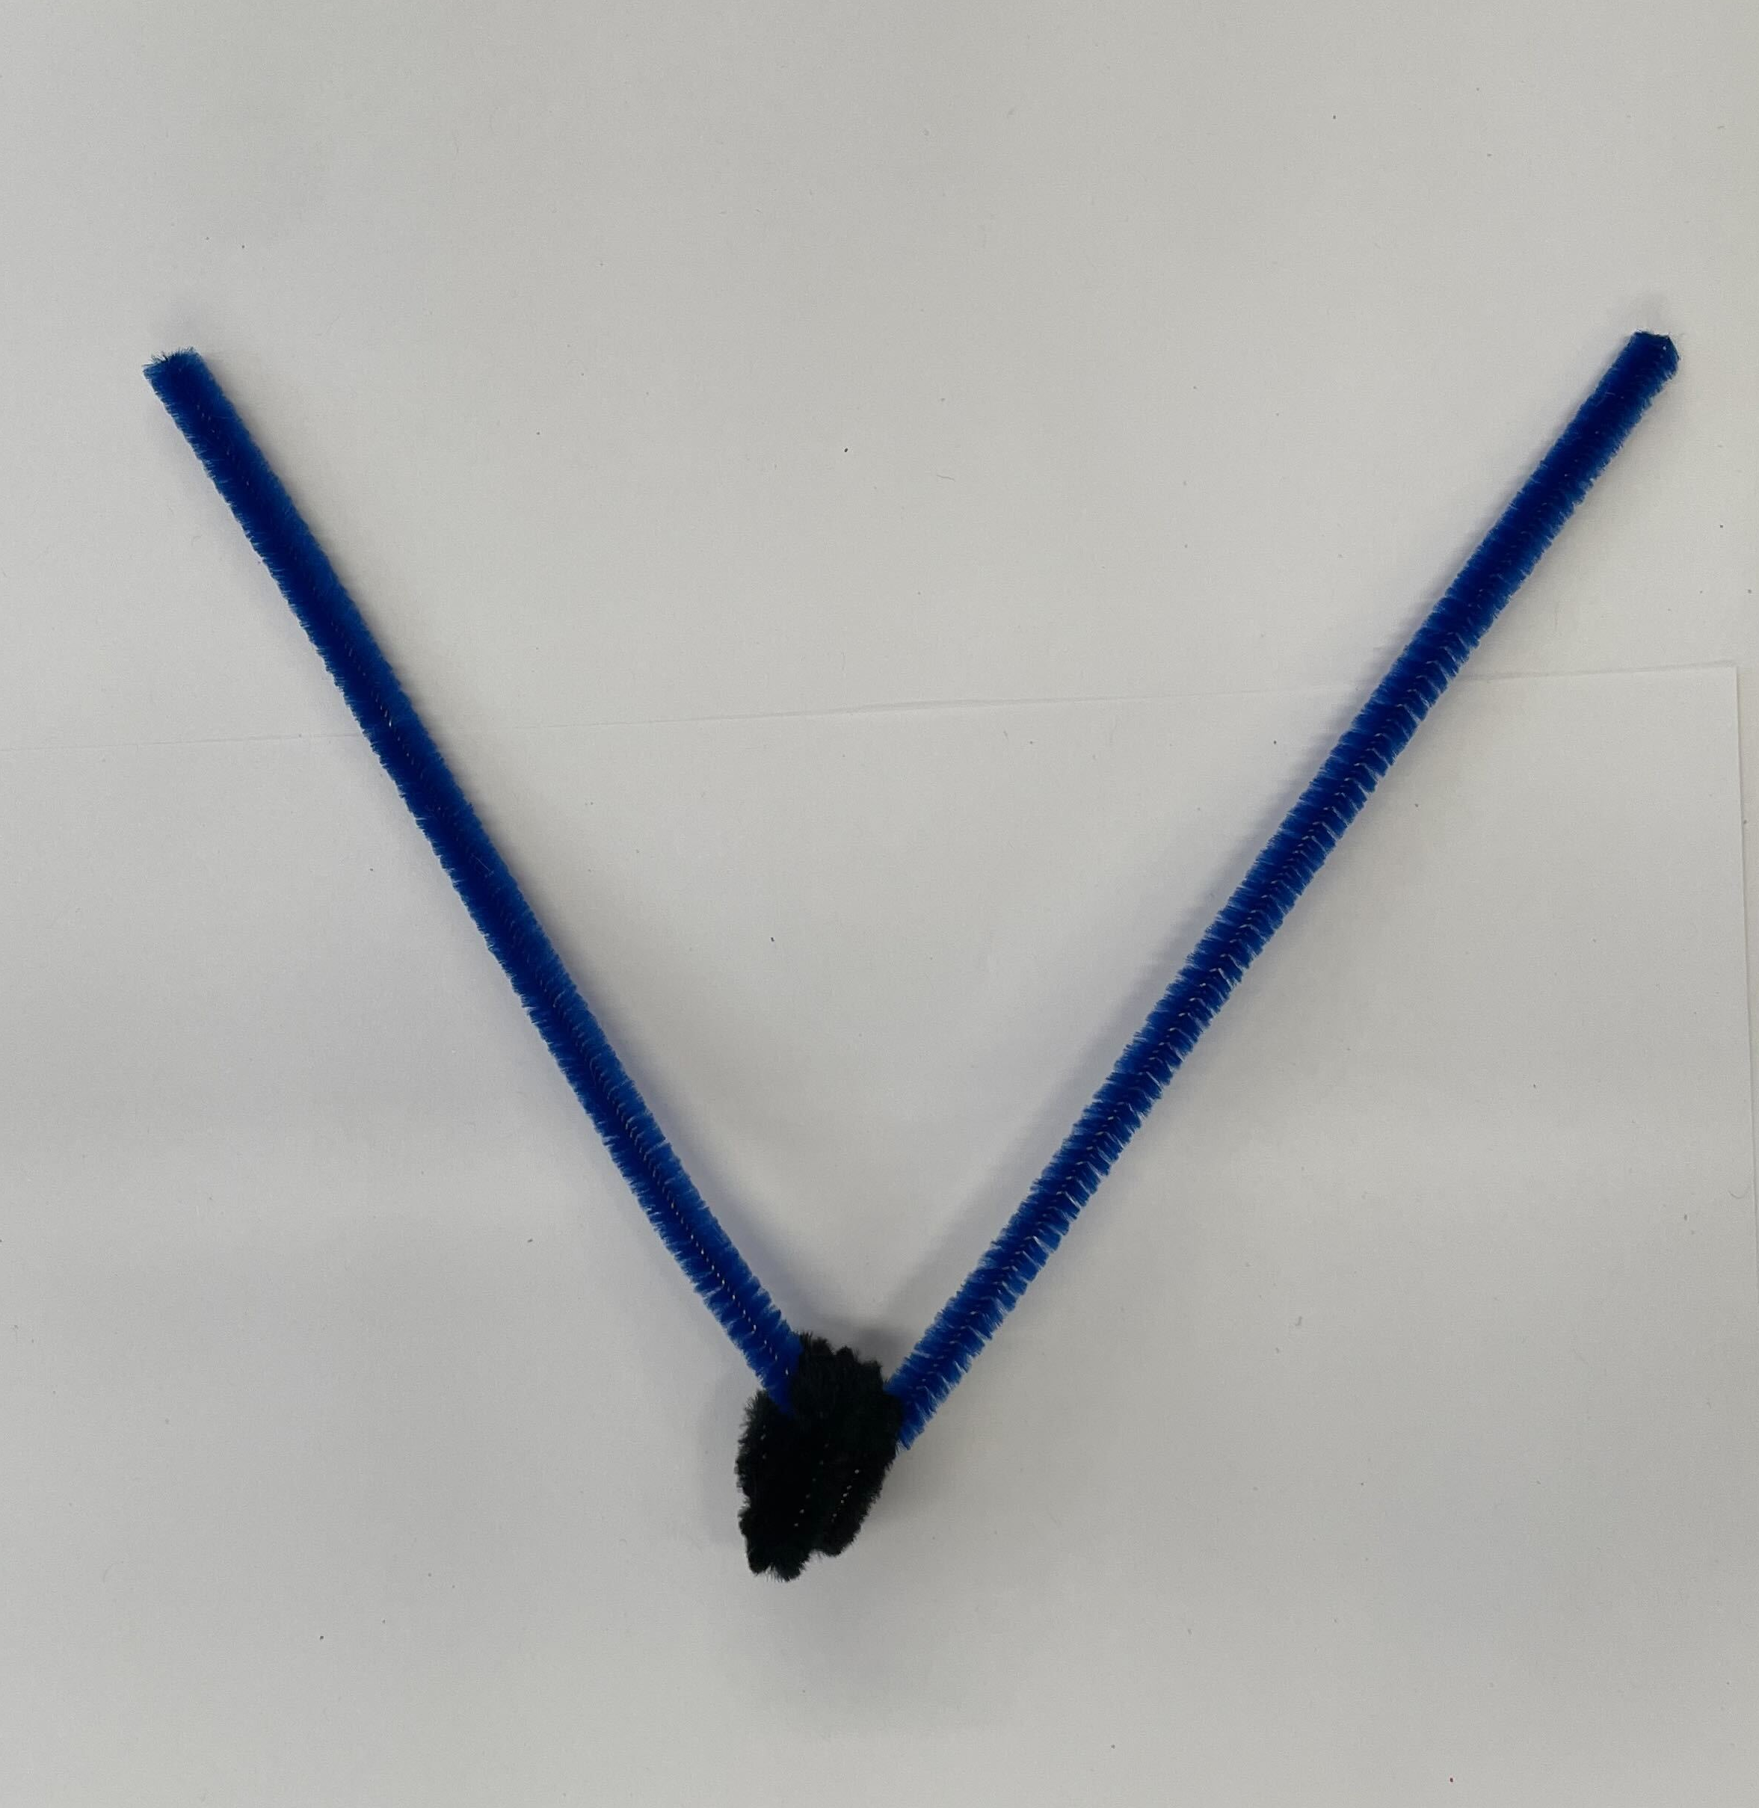
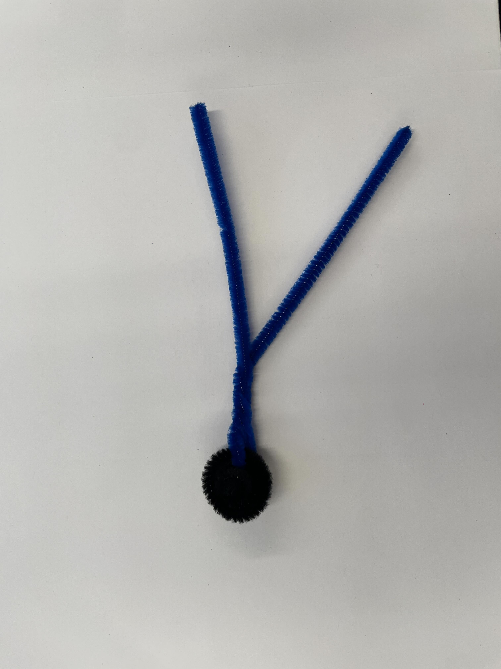
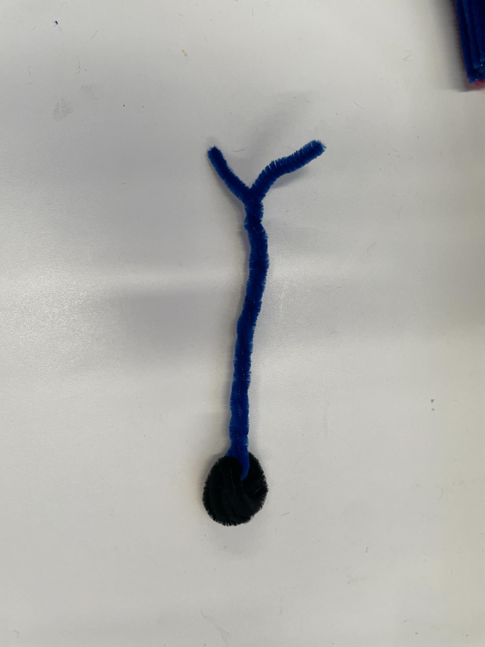
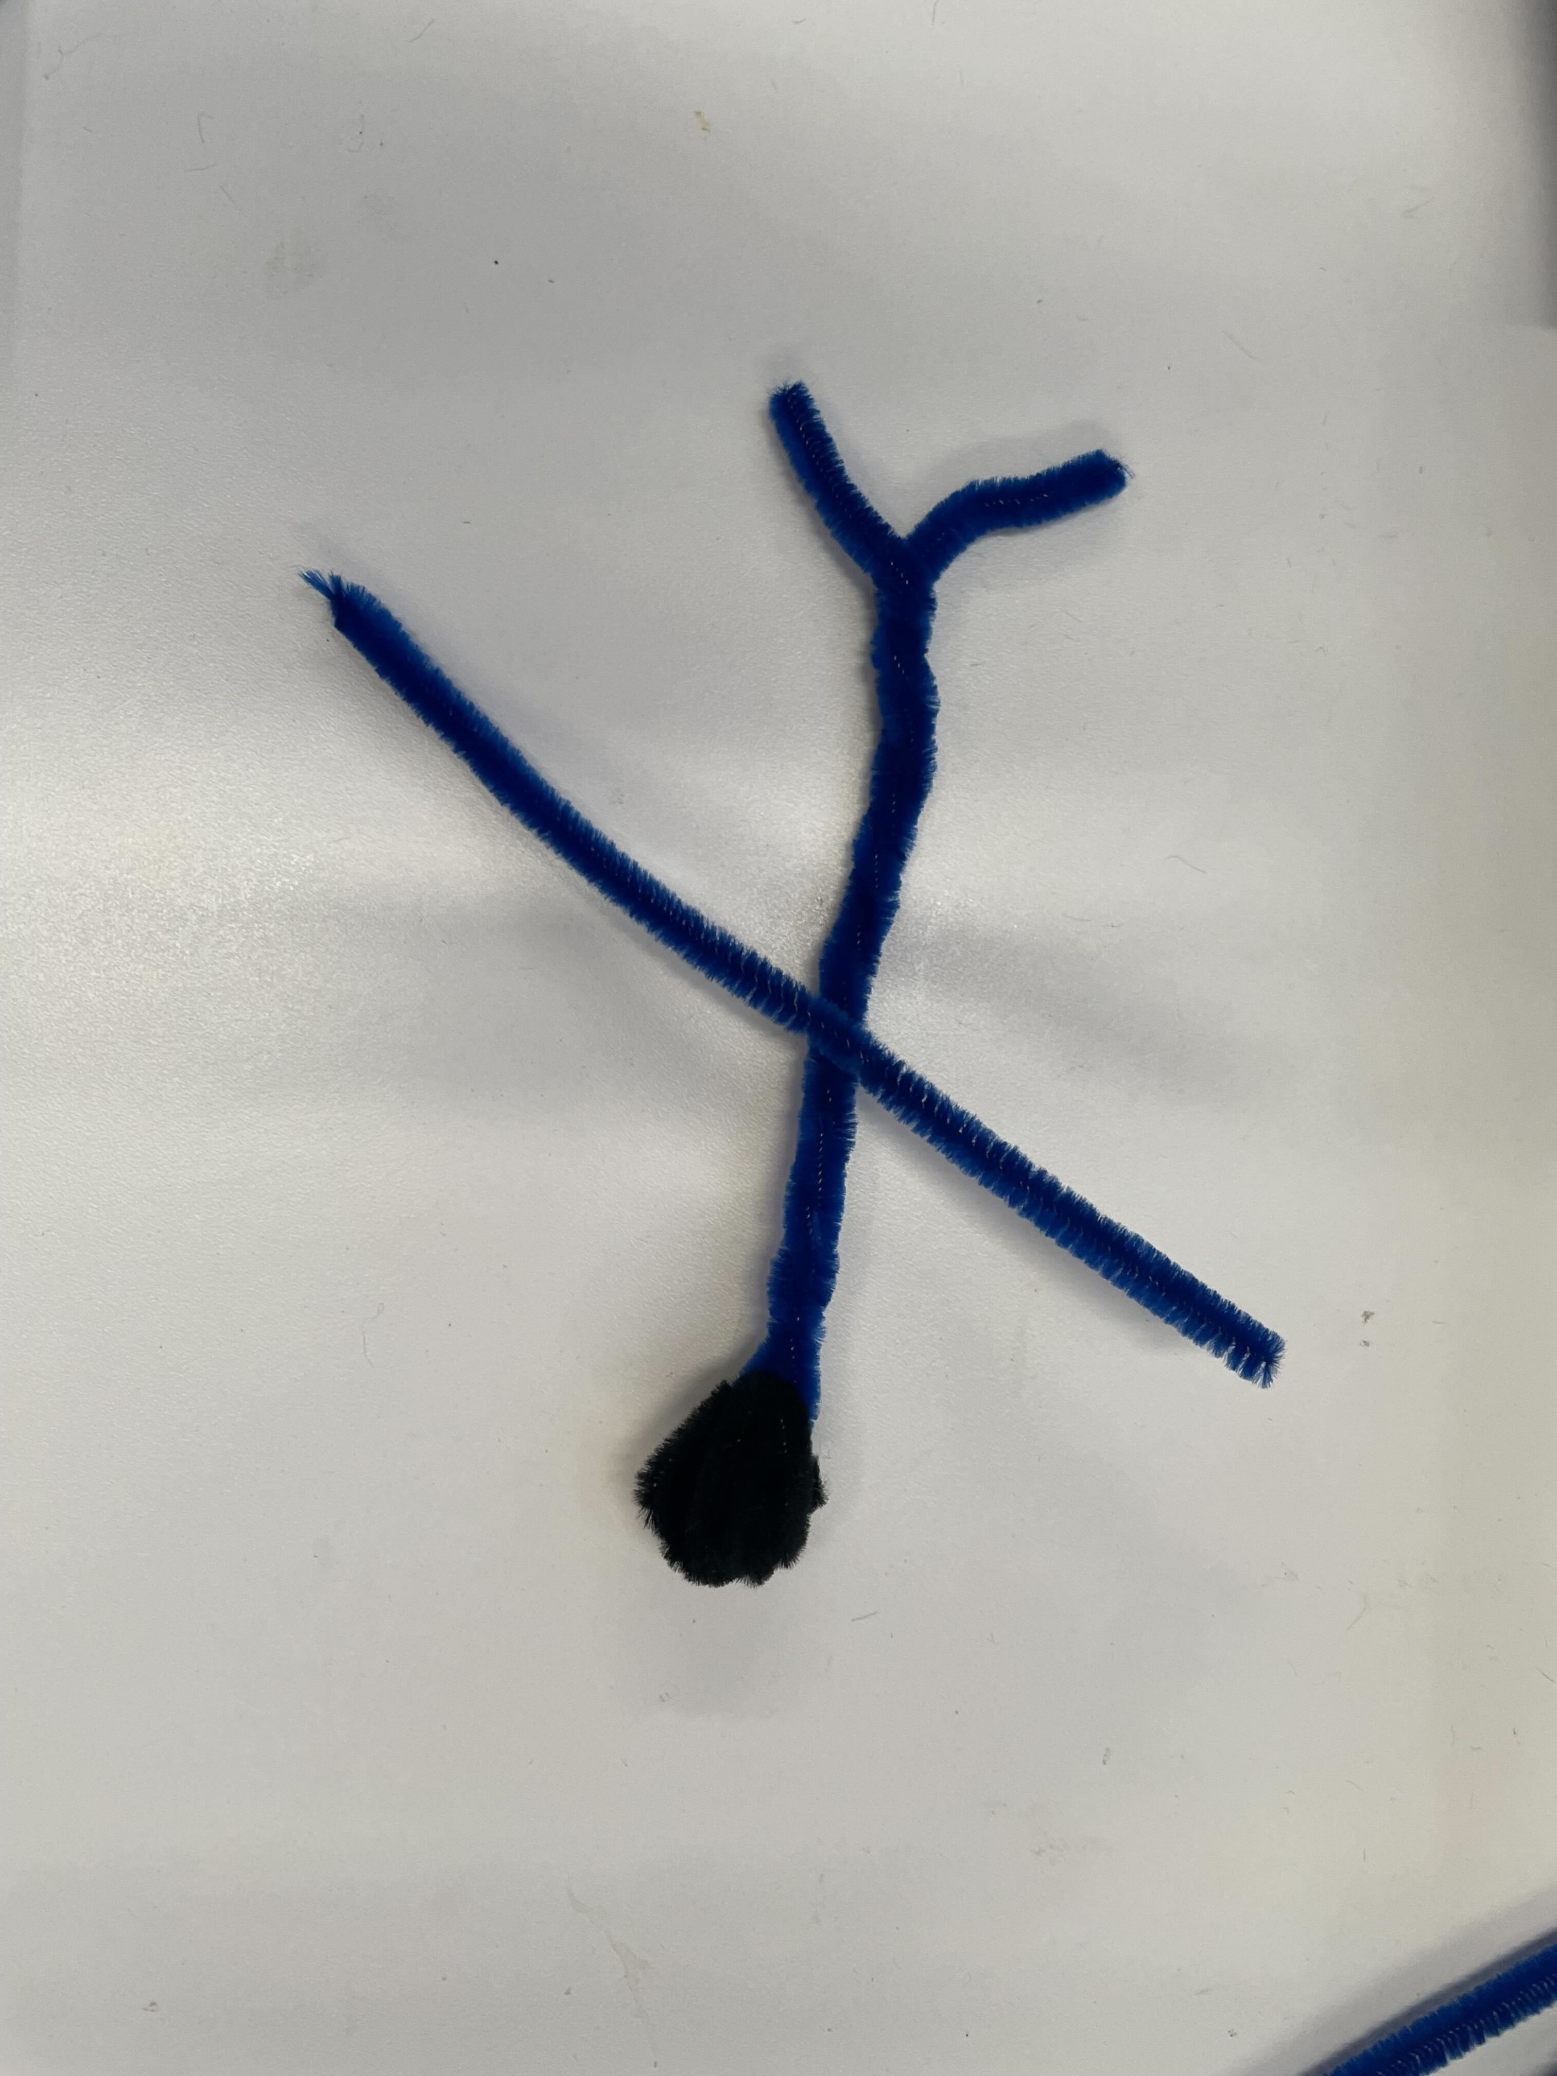
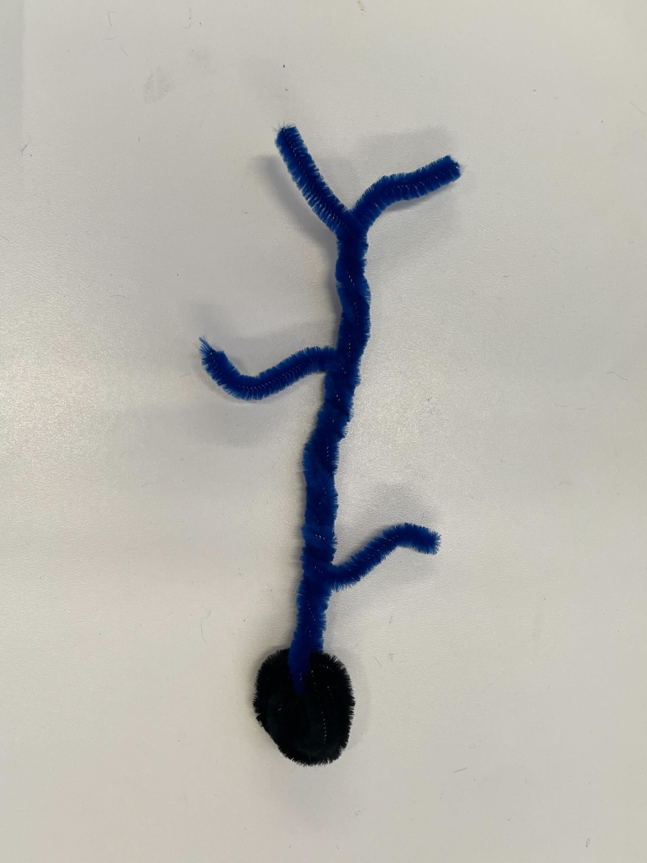
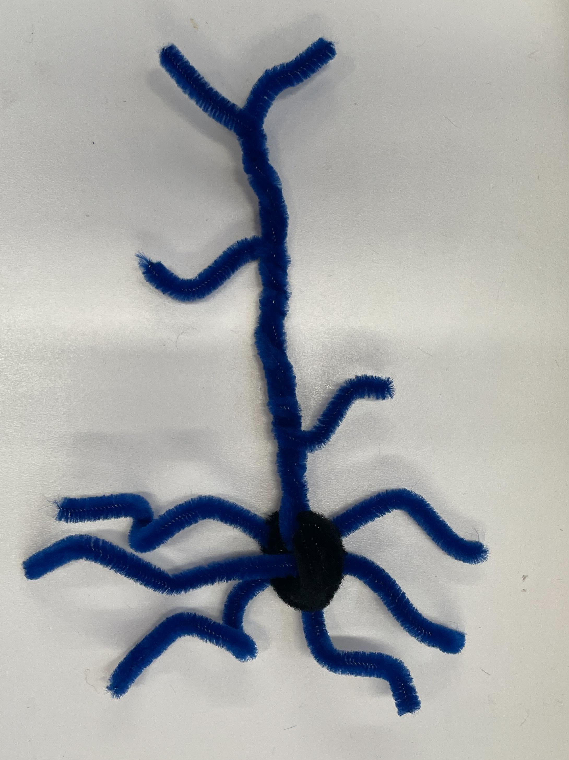
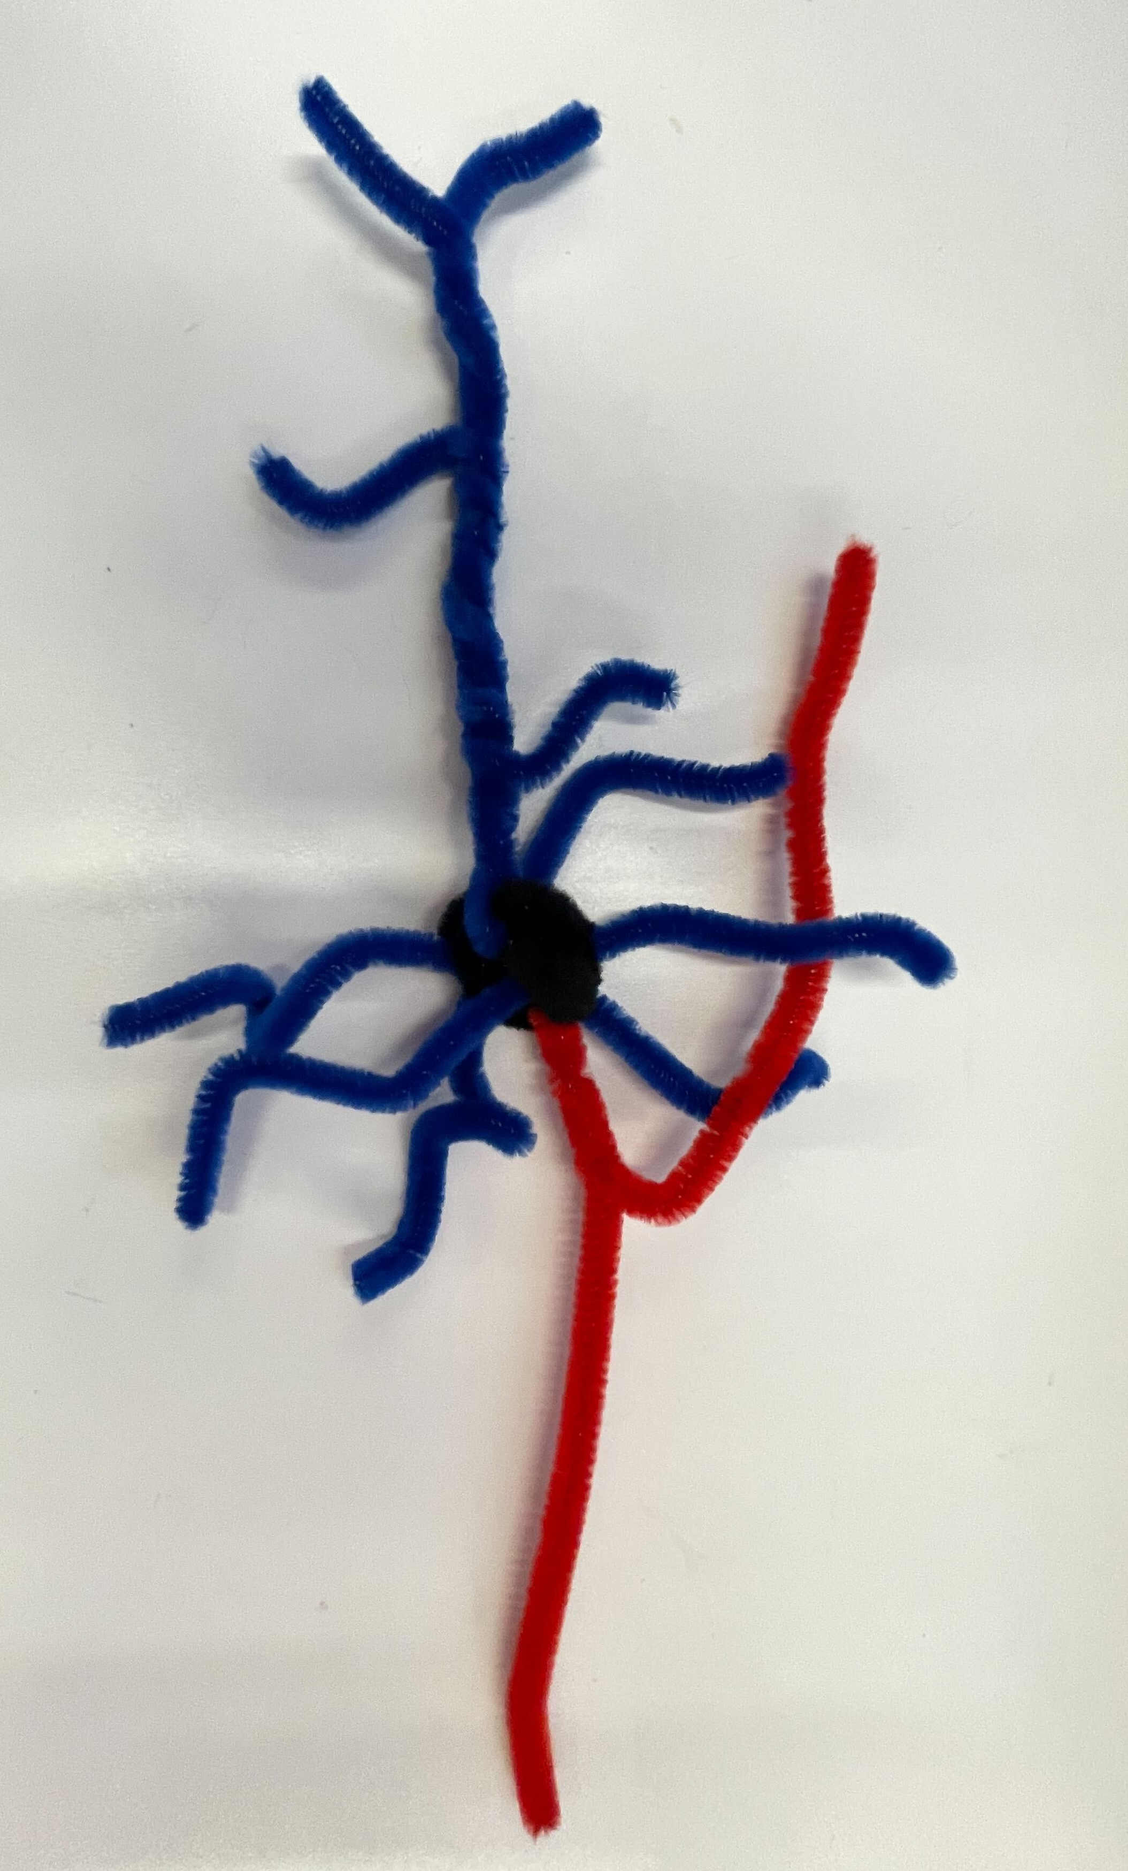
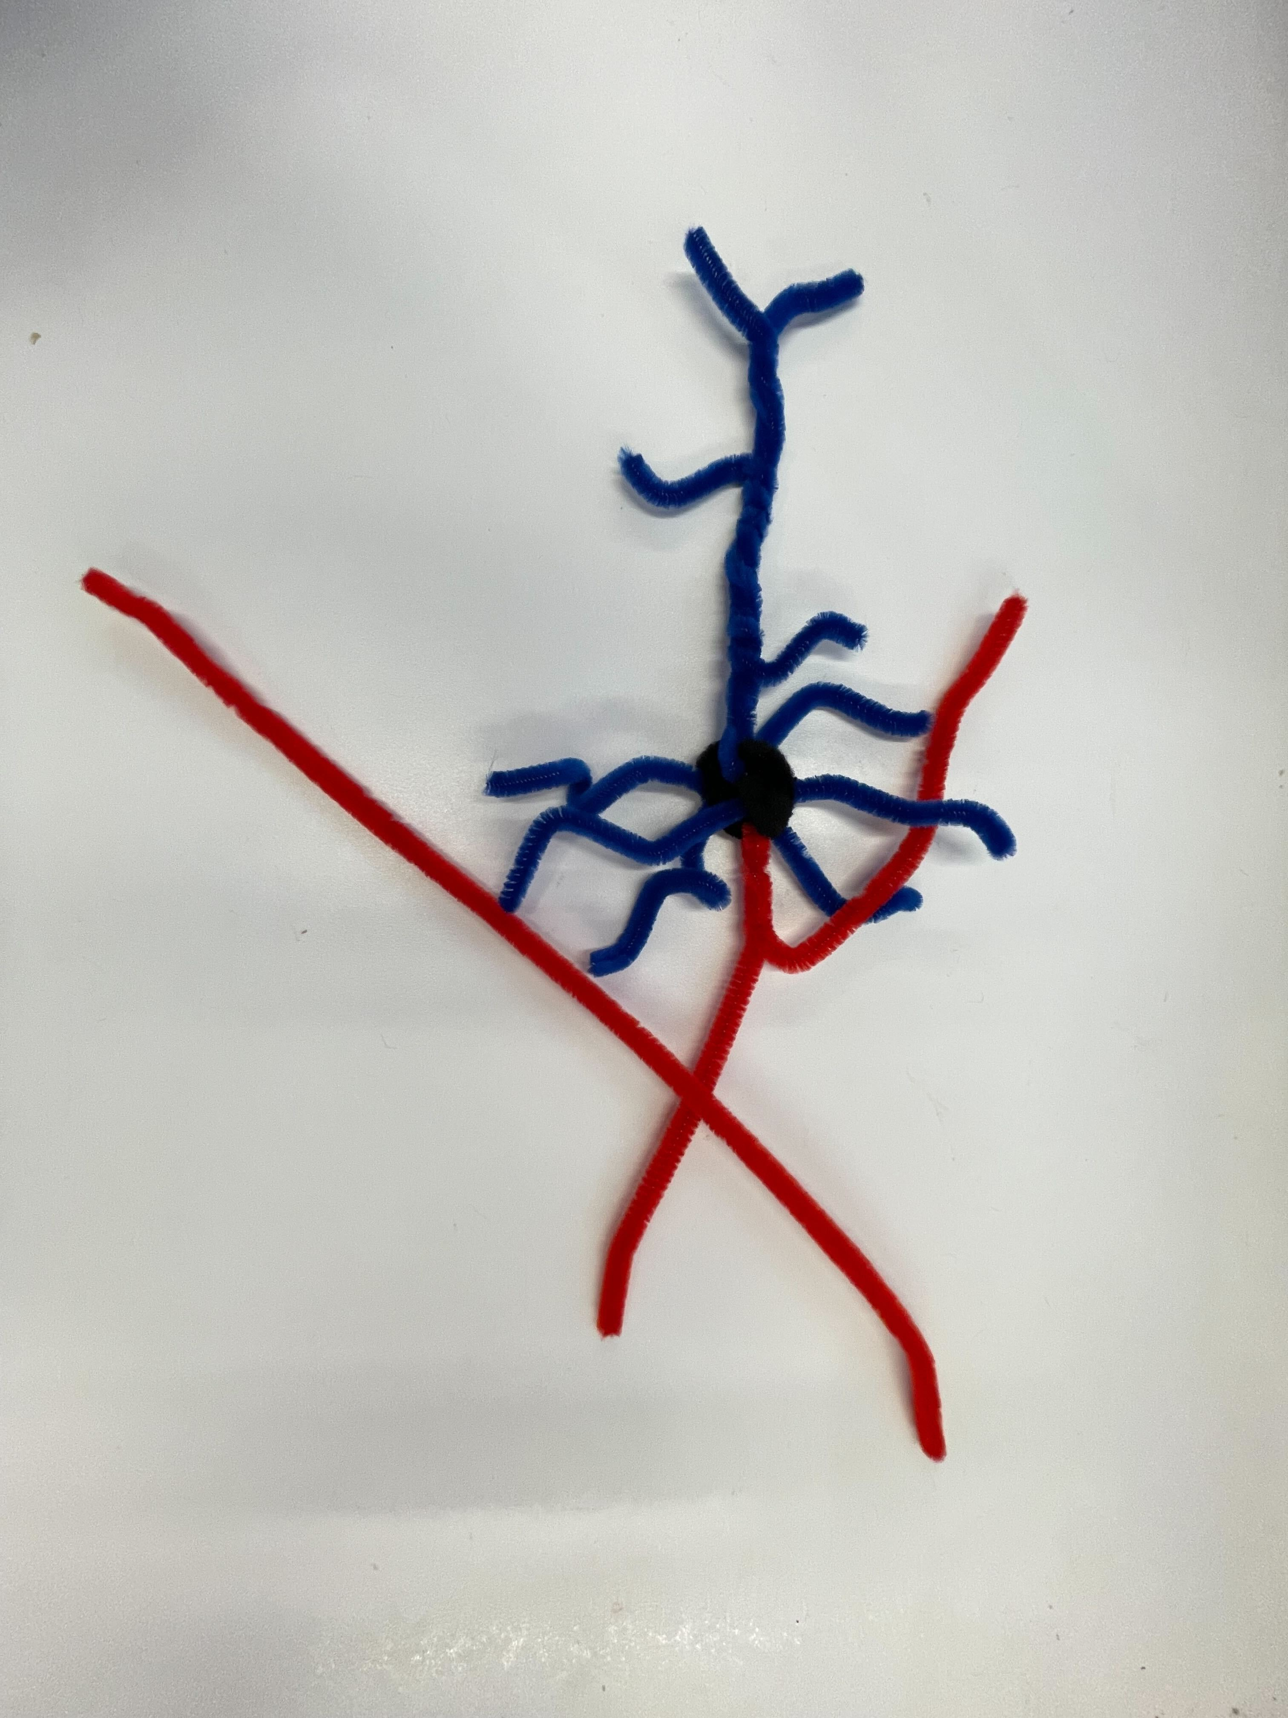
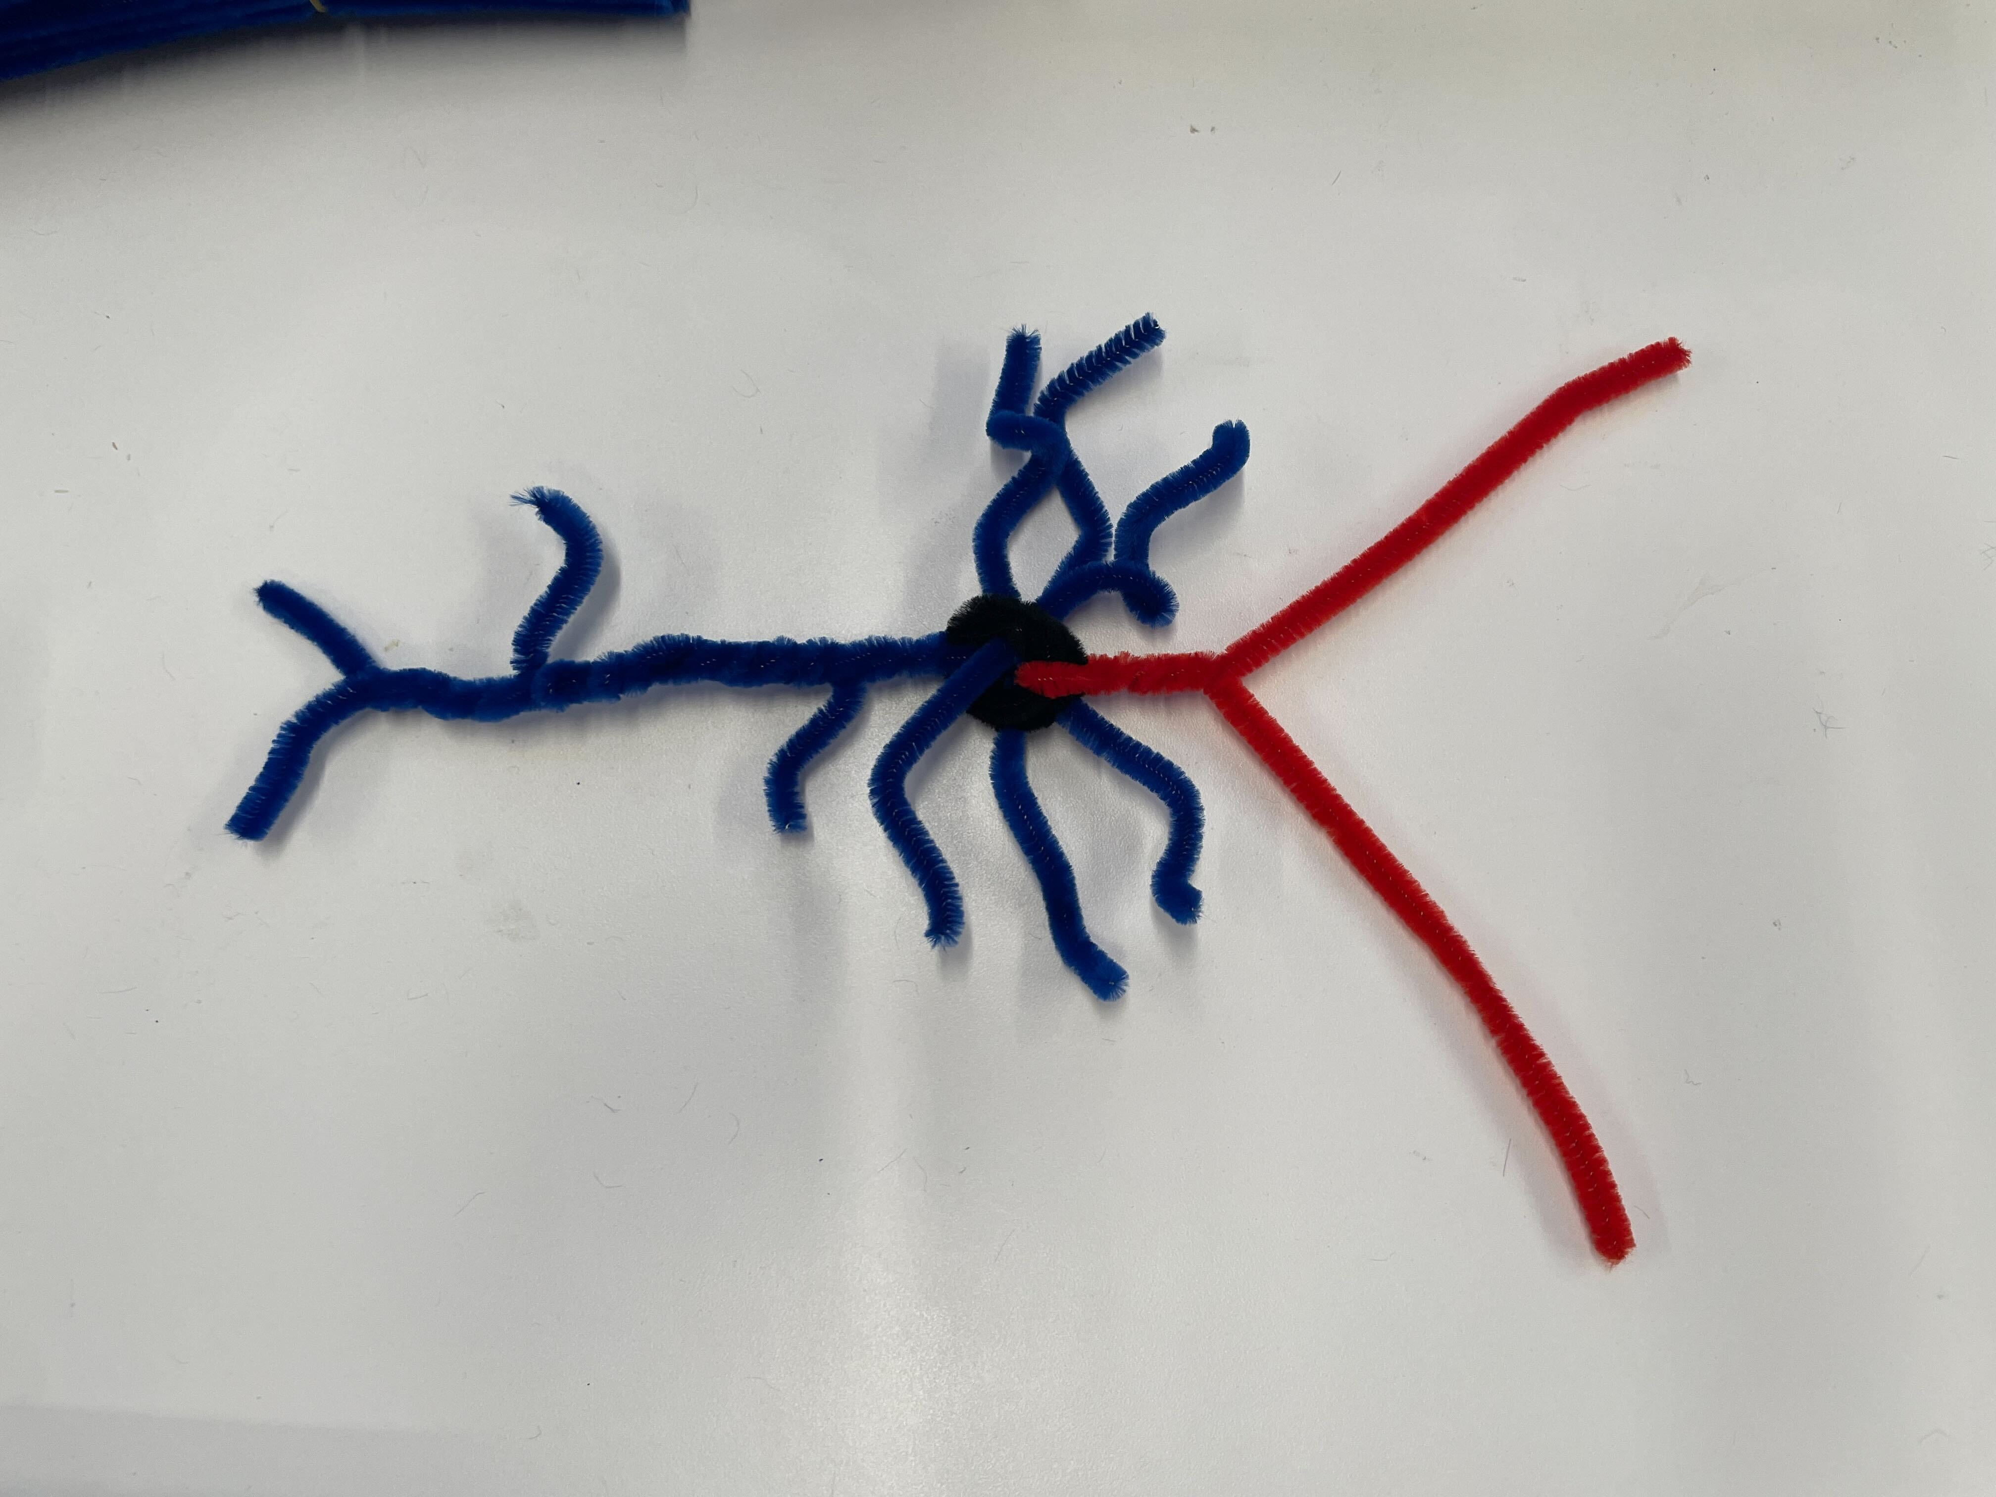
Building your excitatory neuron
Notes:
Roll the black pipe cleaner into a ball. This is your cell body, or soma, that contains the nucleus and other important organelles.
Take one blue pipe cleaner and push it through the soma and point the ends upward. Twist the two halves together until two small branches remain at the end. This is your first dendrite! Dendrites receive electrical signals from other neurons.
Cut the other two blue pipe cleaners in half to make four short pieces.
Lay one of the segments across your first dendrite. Wrap the segment once around the dendrite.
Grab one end of the segment and twist it around the dendrite upward, like you did before. Leave the end loose. The next twist is a little different—take the other end of the segment and wrap it around the dendrite downward instead, toward the soma. Now your dendrite has some more branches.
Push the other three segments through the soma, in all different directions, to make the rest of your dendrites. Make sure to bend and curl each one!
Next you will make your axon. There are multiple dendrites, but only one axon. The axon sends electrical signals to other neurons. Start by pushing a red pipe cleaner through the soma. Point the ends downward and twist it around itself a few times. Stop twisting when the axon is about the same length as the short dendrites.
Bend one end of the pipe cleaner upward and point the other downward. The upward end should overlap with the dendrites.
Now you will add branches to your axon, like you did before with your dendrite. Grab another red pipe cleaner and lay it across the downward axon branch, the one you haven’t used yet. This time place the pipe cleaner so that one side is longer than the other. Wrap it around the downward branch once.
Take the long end of the new pipe cleaner and bend it upward so that the cell has two upward axon branches. Take the short end and twist it downward around the main axon. Leave the ends loose. Now your axon has all its branches.
You have now made your very own excitatory neuron!

Slide 7
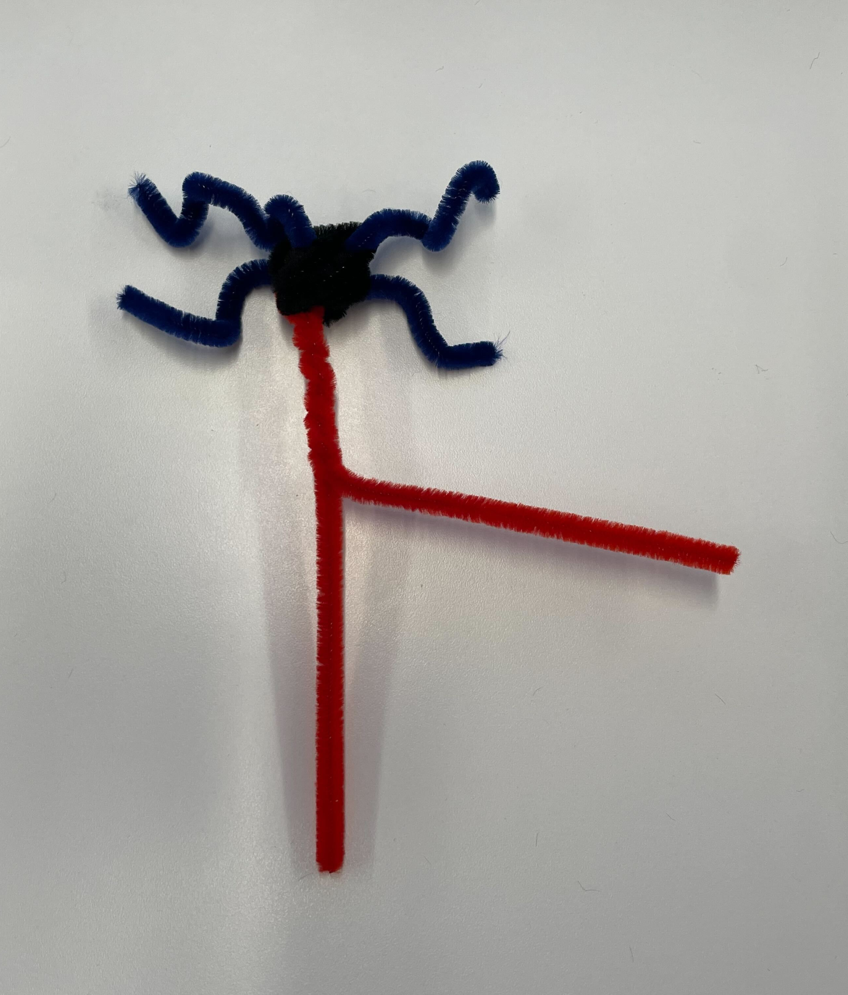
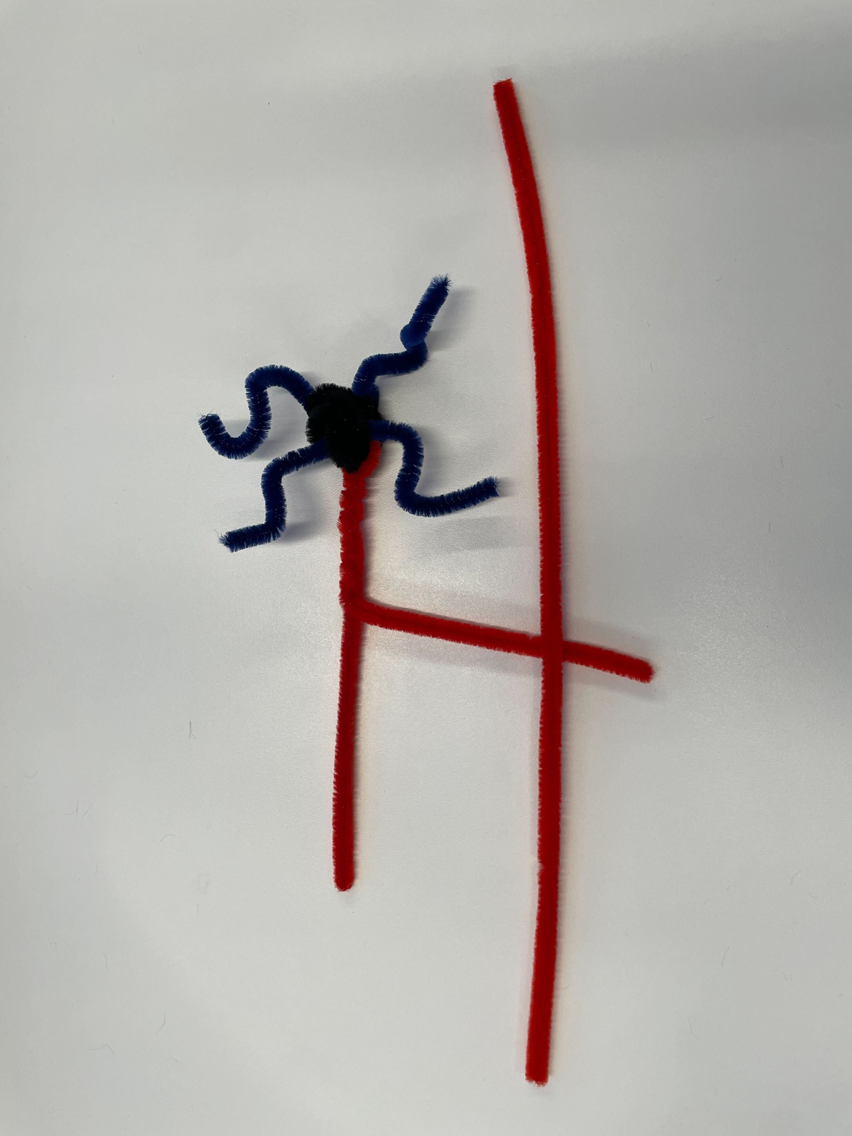
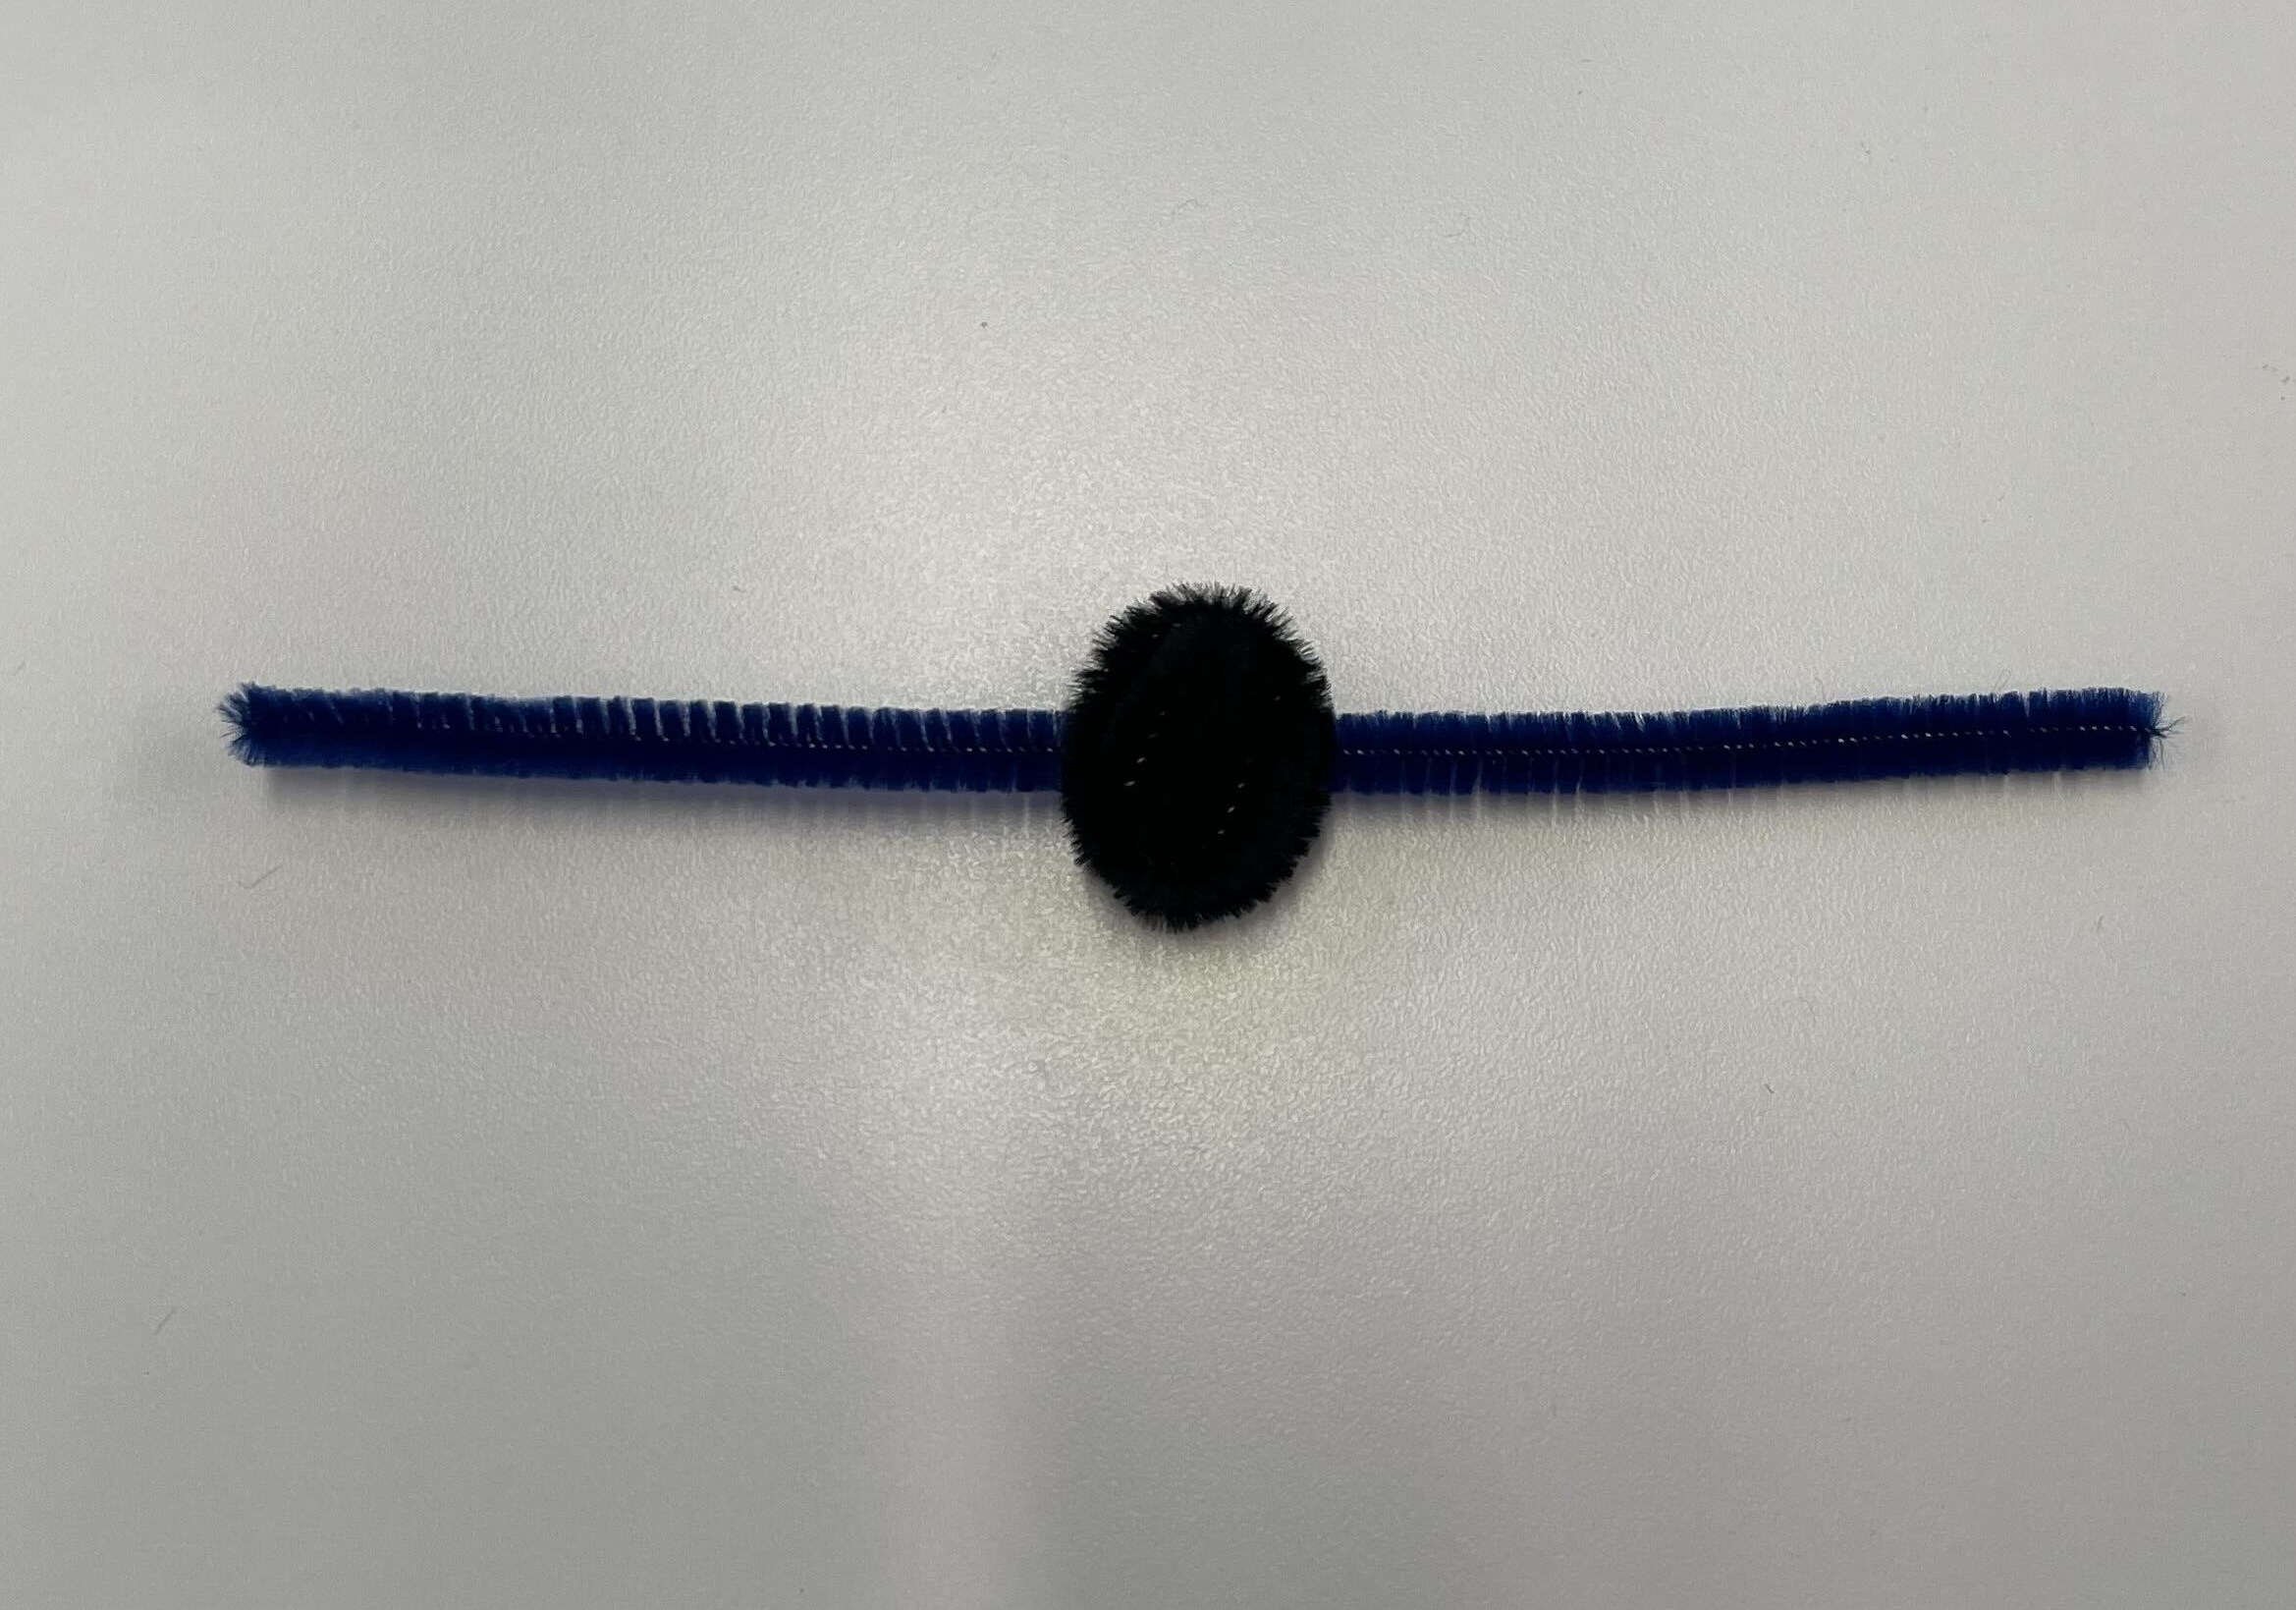
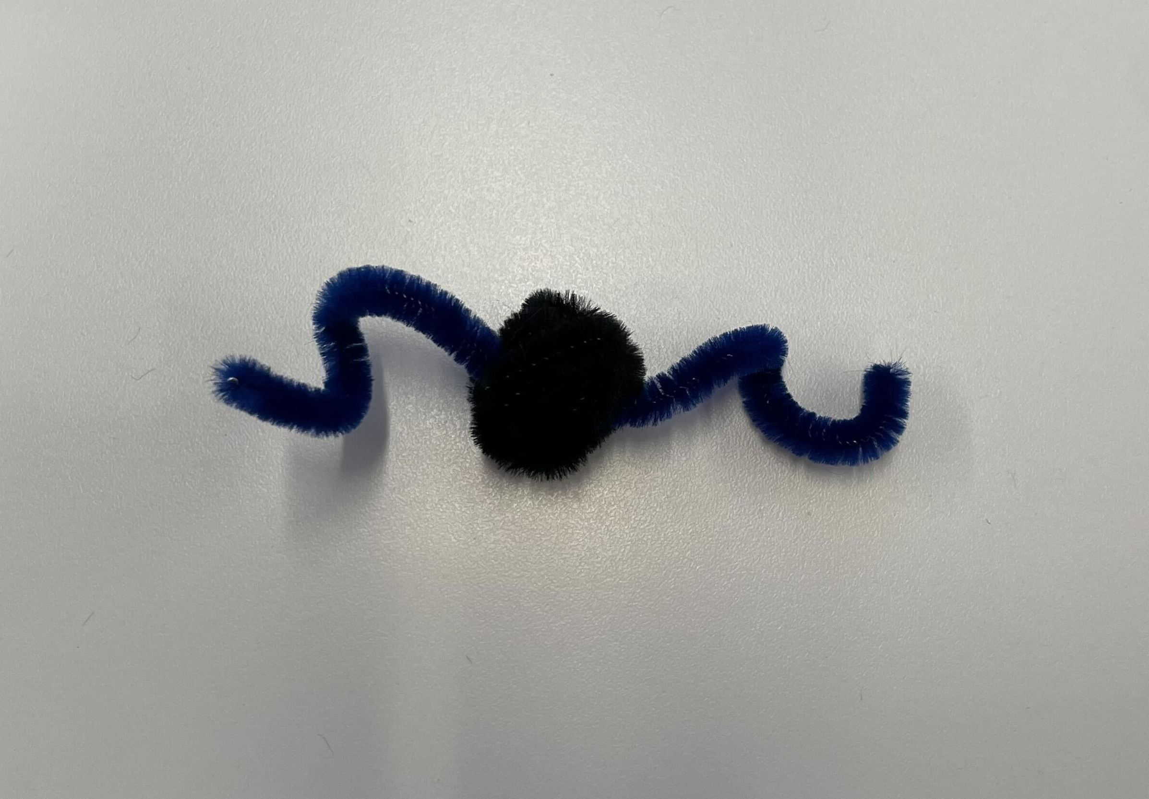
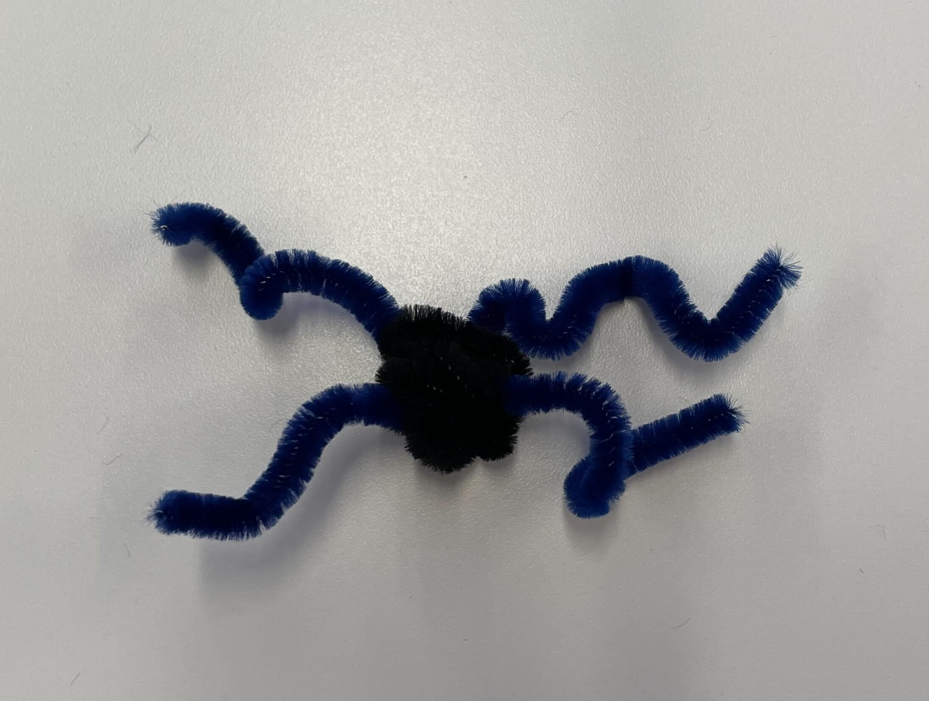
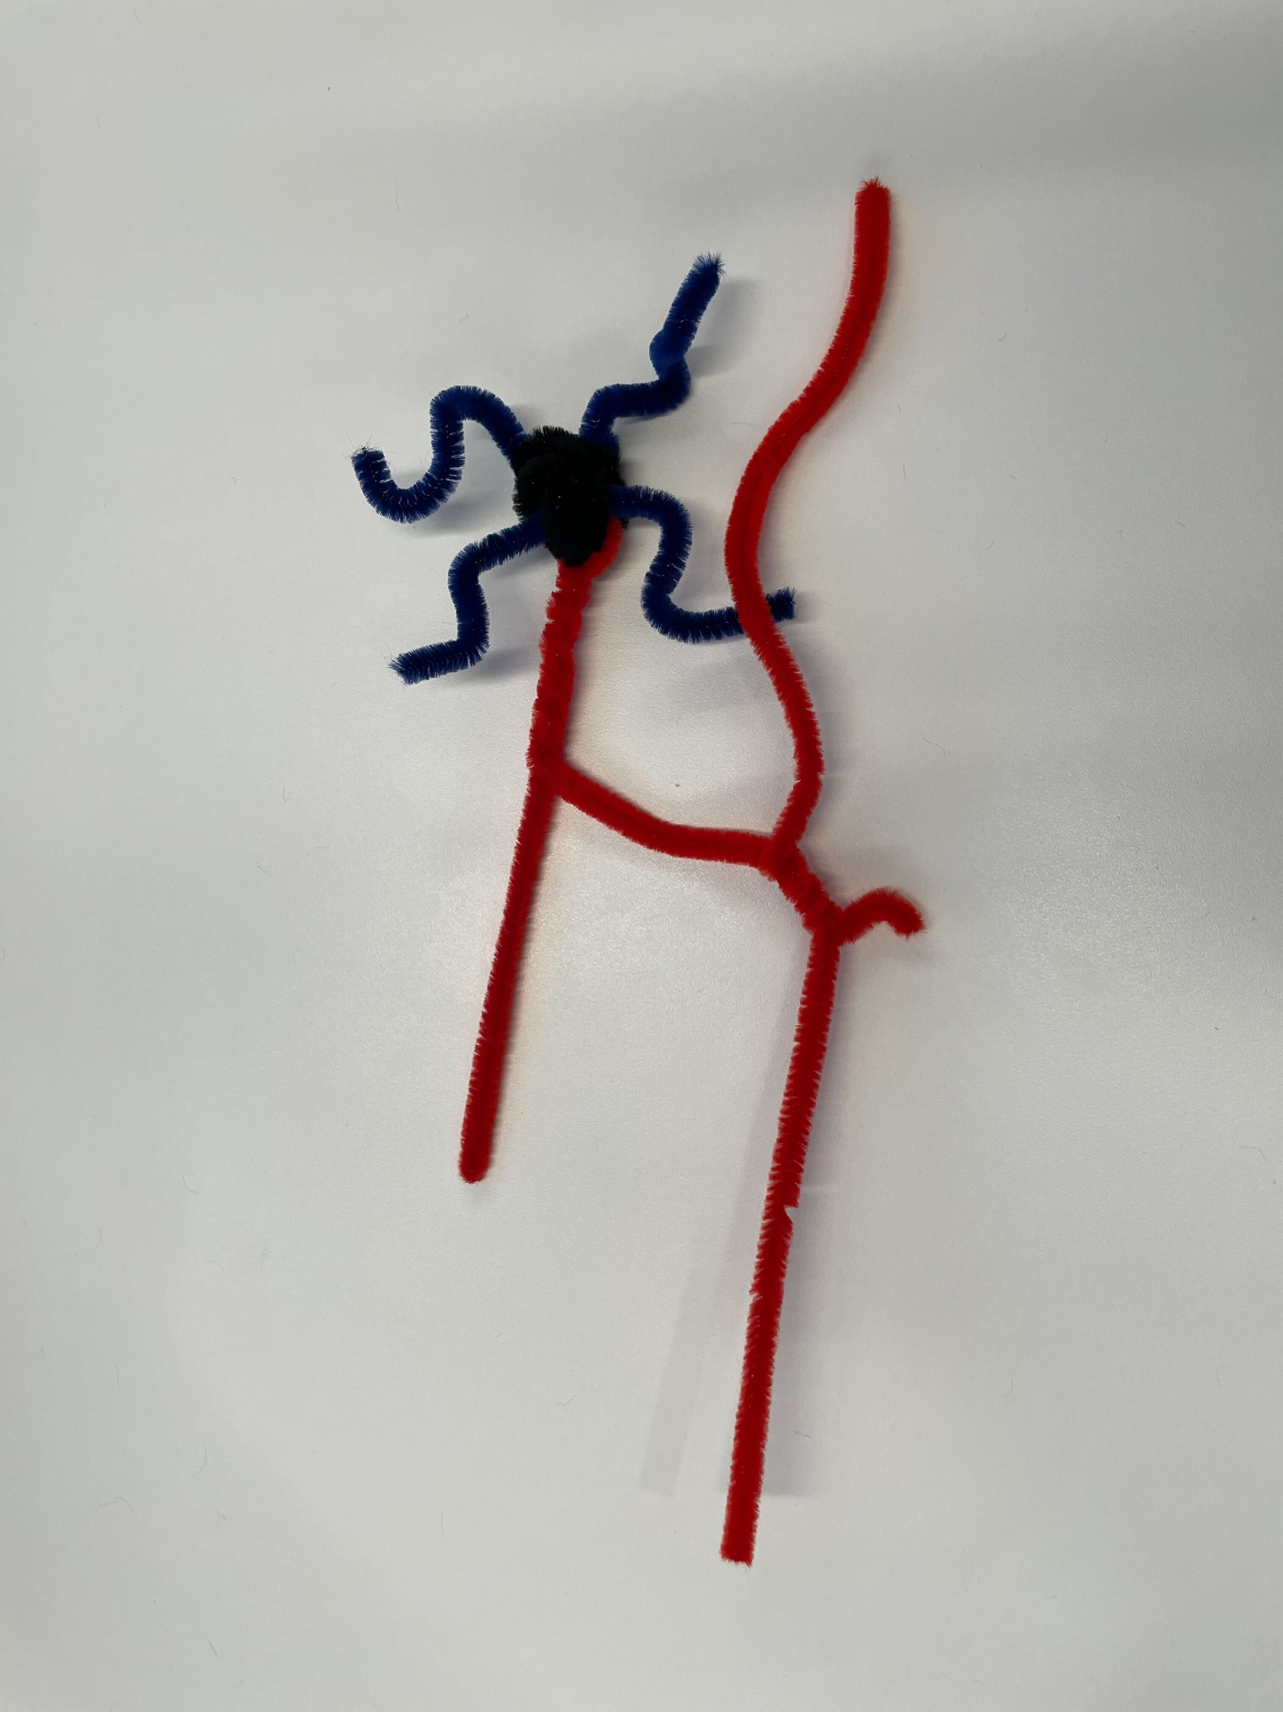
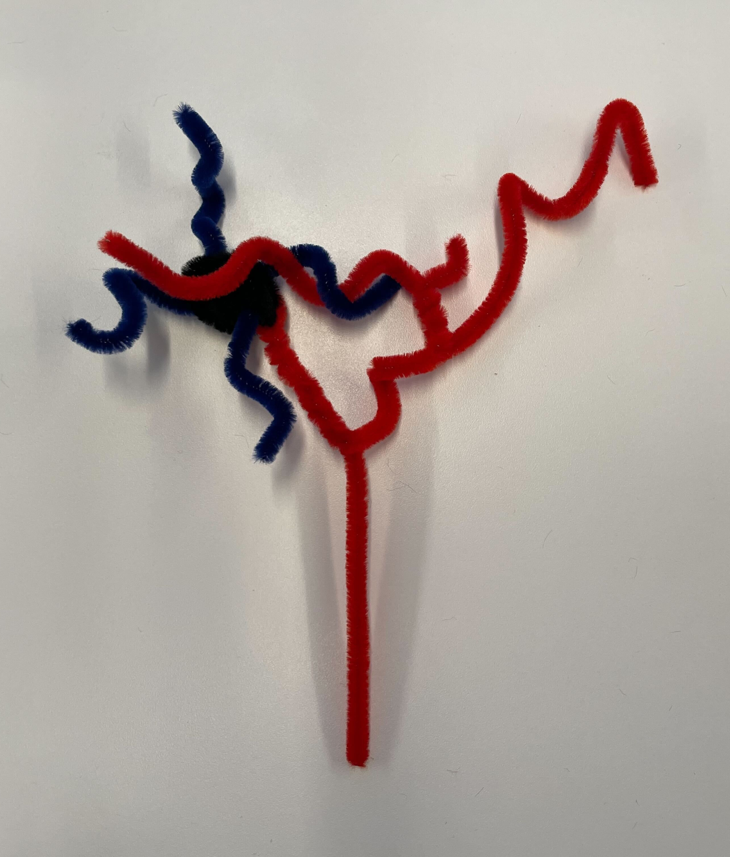
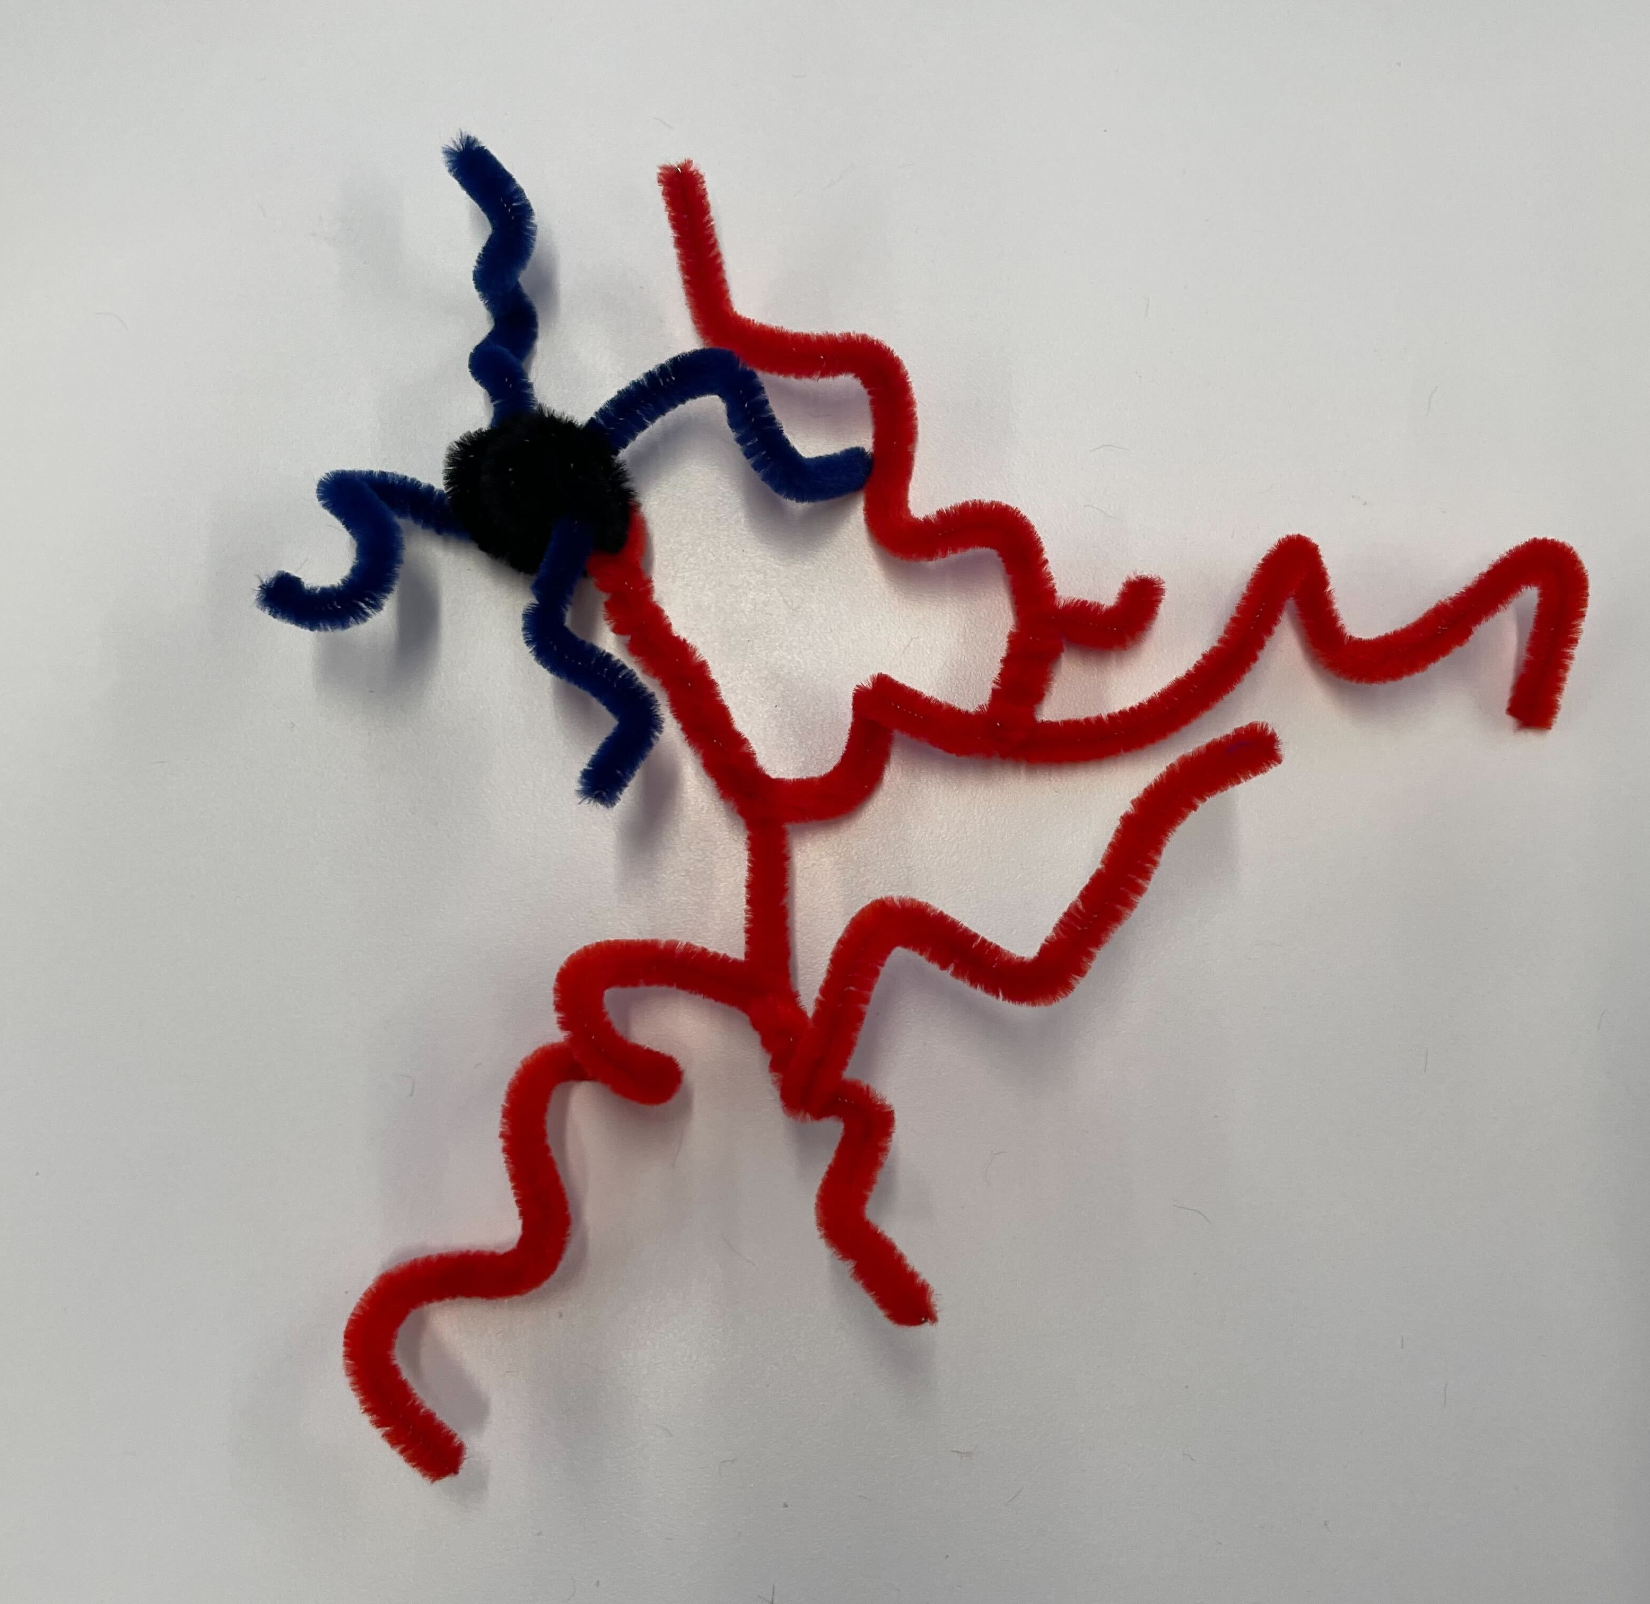

Building your inhibitory neuron
Notes:
Roll the black pipe cleaner into a ball. This is your cell body, or soma, that contains the neuron’s DNA and other important parts.
Cut the blue pipe cleaner in half. Push the two halves through the soma to make your dendrites. Dendrites receive electrical signals from other neurons. Make sure to curl your branches and point them in all different directions!
Next you will make your axon. The axon sends electrical signals to other neurons. Start by pushing a red pipe cleaner through the soma. Point the ends downward and twist it around itself a few times, then bend one of the ends to point sideways.
Now you will add axon branches, just like you added dendrite branches to your excitatory cell (see slide 5, step 5). Lay your second red pipe cleaner on the sideways axon branch you’ve made. Wrap the new segment once around the branch.
Grab one end of the segment and twist it around the axon branch toward the soma. Take the other end of the segment and wrap it around the axon branch away from the soma. Leave the ends long this time.
Bend and curl the branches in the section you just made, and then move that entire section upwards to tangle in the dendrites.
Go back to the downward-pointing axon end and use your last pipe cleaner to add more branches, like you did in step 5.
Finally, twist and curl your axon all over. Bend the entire axon upward and ball it up around the soma. Tangle the axon and the dendrites together, so they overlap.
You have now made your very own inhibitory neuron!

Slide 8
Extension: Connecting Neurons
More excited
Less excited
Excitatory
Excitatory
Inhibitory
Excitatory
More inhibited
Less inhibited
Excitatory
Inhibitory
Inhibitory
Inhibitory
Notes:
When one neuron sends signals to another, it changes how that other neuron behaves. Different kinds of cells change the behavior of other cells in different ways. As we’ve learned, there are excitatory and inhibitory neurons. When an excitatory neuron sends out signals, it tells other cells to signal more. When an inhibitory cell sends out signals, it tells other cells to signal less.
What happens when we think about three cells connecting instead of two? Look at these two cells [first figure]. When the first neuron changes the signal of the second neuron, what happens when the second neuron talks to other cells? When an excitatory neuron tells another excitatory neuron to signal more, what happens to the third cell? Now let’s look at these other types of connections. What happens to the third cell when it receives signal from the second cell?

